Slide 1
Week 4 – Content Generation

Slide 2
Recap on Twitter

Slide 4
Creating a GIF – what is a GIF?
Graphics Interchange Format. GIFs are image files that are compressed to reduce transfer time. It can also use multiple images for animated effects (animated GIFs), but has no sound.

Slide 5
Use GIPHY!
To create your own unique GIFs using video content
https://giphy.com/

Slide 6
Picture Perfect
Tweets with images received 150% more retweets than tweets without images.
On Instagram, photos showing faces get 30% more Likes than photos without faces.
Facebook posts with images get 2.3 times more engagement than posts without images.

Slide 7
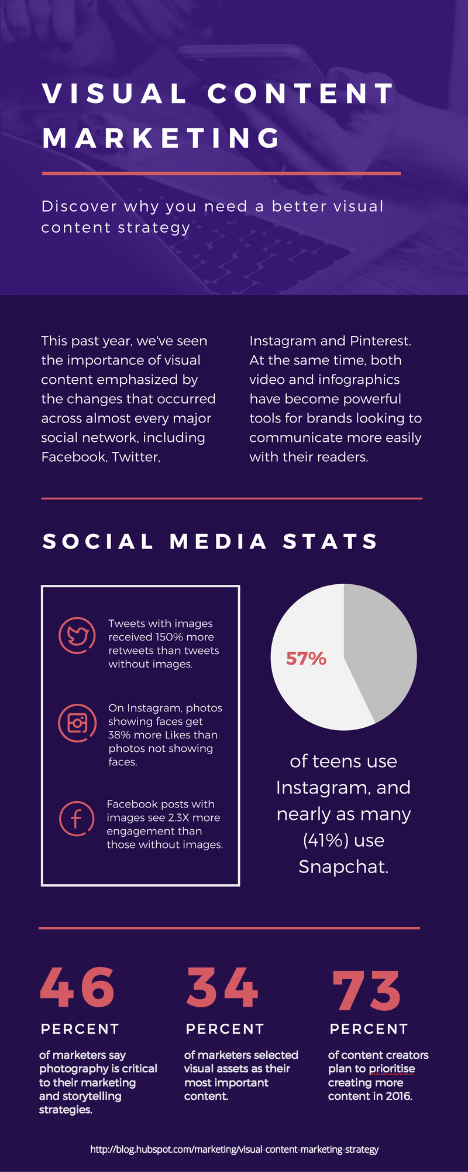

Slide 8
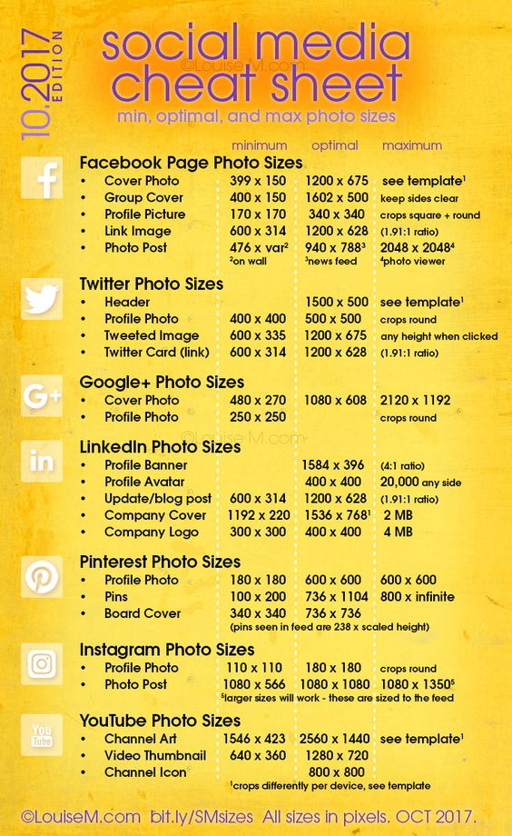

Slide 9
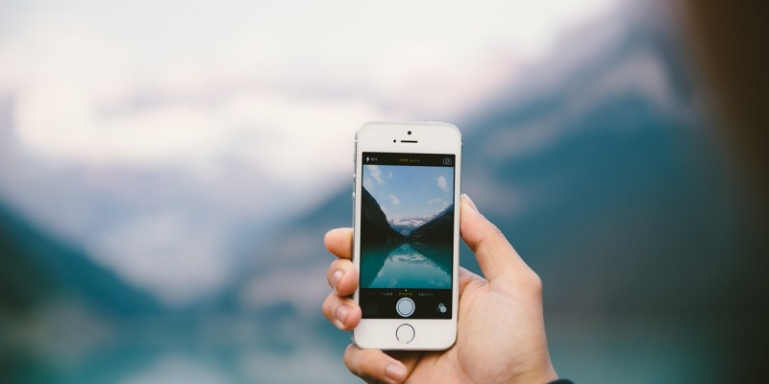
Tips for taking good photos on social media…

Slide 10
Homework
Next week take three pictures:
A place you visit
A Christmas tree
A selfie
Experiment with filters and how you can transform your image.

Slide 11
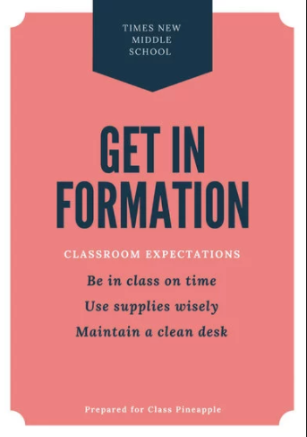
Create designs for Web or print: using these FREE tools as an alternative to Photoshop
https://www.canva.com
https://getstencil.com
https://snappa.com
https://www.befunky.com/create/
https://desygner.com/

