Slide 1
Social Media For Marketing

Slide 2
Introductions

Slide 3
My name is Ashley Mackie
ashley@ashleymackie.com
Downloads are available here: http://www.talentedmarketing.com/social-media-for-marketing.html

Slide 4
What is social media?
Social media is a way for people and business to communicate and interact online both professionally and personally
Last decade has seen a surge in popularity
Users engage with (and around) in a social context – conversations; commentary; user-generated content and engagement

Slide 5
It was reported that Facebook (89%) and LinkedIn (83%) are the most valued social media platforms to use, which is no surprise as Facebook has the largest user rate and LinkedIn has been created with B2B objectives and aims in mind, making it a perfect platform to generate leads and increase conversion.

Slide 6
Facebook has a wide range of users globally, making it a perfect platform for companies to target their desired customer. With features like groups, pages and 'likes' it can also bring together a group of users with similar interests making it much easier for brands to target a larger audience all with their desired personas.

Slide 7
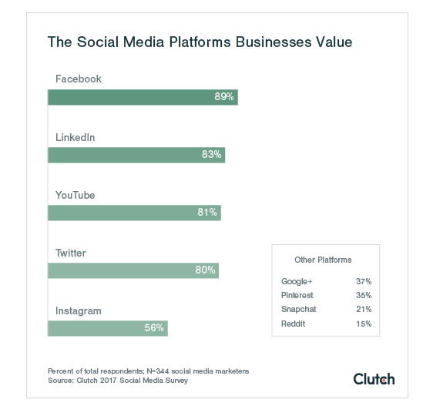

Slide 9
Instagram is a great platform for companies and brands that rely heavily on visuals and storytelling to increase engagement, generate leads and convert potential customers.

Slide 10
Pinterest, a visuals board, can give the same content to target audiences as Instagram (a more popular social platform), and with the integration of stories and filters on Instagram and Facebook it has rendered Snapchat's trademark media platform obsolete in the eyes of many businesses. However, Snapchat remains the social platform teenagers spend the most time on, making it a valuable asset to your marketing strategy if your brand's target audience is Generation Z.

Slide 11
Why do companies use social media?
Gain valuable customer insights
Increase brand awareness and loyalty
Run targeted ads with real-time results
Generate higher conversion leadds
Increase website traffic
Look at competitors
Share content
Build relationships
It is FREE?

Slide 12
What content engages customers?
With users scrolling through 300 feet of content per day…

Slide 13
Kat Hahn from Facebook suggests how brands can stand out, in a way that reflects the way users consume content on social media:
On the go - short and snappy
Lean forward - interactive content
Lean back - immersive content, longer and goes into detail

Slide 15
According to the graph, written articles (27%), videos (26%), and images (24%) are the three most engaging content on social media.

Slide 16
Original vs shared content
Nearly 80% of businesses share mostly original content and only 19% of companies share only original content.
Sharing and posting content that only your company produces increases your own brand awareness and shows customers more about yourself.
Sharing your own content that has not been published/seen anywhere else can drive higher engagement, after all, users don't want to see the same content on their social feeds. producing original content can increase engagement rates with your brand.

Slide 17
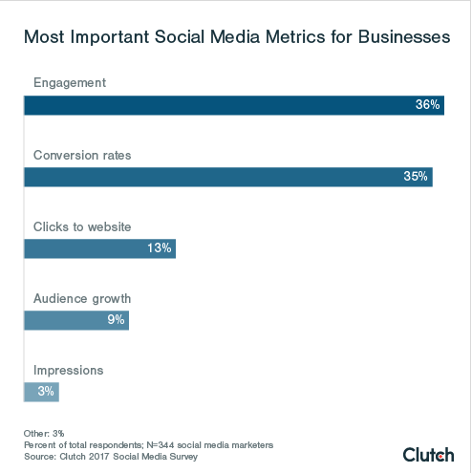

Slide 19
Facebook still remains the most valuable social platform for B2C companies, with many of their customers making purchasing decisions online. However, LinkedIn (93%) is the most valuable social platform for B2B companies and then Twitter (83%).
This is because of the professional nature of these platforms, it's much easier to reach and engage with business professionals and professional company pages/profiles.

Slide 20
The top challenges to social media marketing are:
Not enough resources, including human and financial
No formal strategy in place – lack of corporate guidelines
Building followers and social media influencers
Consistent tone of voice
Ideas

Slide 21
Impress your team with these stats…
52% of businesses say that social media positively influencers revenue and sales
Nearly 80% of businesses share mostly original content
44% of companies use social media management software
Only 28% of companies use social media marketing agencies…

Slide 22
More B2C companies (53%) consider investing more time and money in social media valuable than B2B companies (46%)
Written articles (27%), videos (26%), and images (24%) are the three most engaging types of content on social media

Slide 23
The acronym PRACER
PLAN. Create a digital marketing strategy
REACH. Grow your audience online
ACT. Encourage brand interactions and leads
CONVERT. Increase sales through optimisation
ENGAGE. Build customer loyalty and advocacy
RESOURCES. Tools to help you create and implement your plans

Slide 24
The 90 Day Social Media Plan
A 90-day social media marketing plan gives you enough time to gain valuable insights into how well a strategy or strategies are working, while allowing for those that aren’t to be tweaked or abandoned before they do too much damage to your bottom line.

Slide 25
The 90 Day Social Media Plan
Set Goals:
The end goal for your campaign could be a number of things—increased social media engagement, website traffic, lead generation, conversions or some combination of all of these.
Specific is always better than general—"surpass 5,000 followers" is better than “get more followers,” for example.
Based on your goals you can get a sense of what kinds of audiences to target, what kinds of ads to run, which social media networks to focus on and other important details of your plan.

Slide 26
The 90 Day Social Media Plan
Define your audience:
Look at buyer personas – look at their interests, demographics, careers and from this you can then craft your content/target ads, etc

Slide 27
The 90 Day Social Media Plan
Plan content in advance:
Facebook: 1-2 posts per day, in the morning and afternoon or evening
LinkedIn: 1 post per weekday morning
Instagram: 1 or more posts per day, as consistently as possible
Google+: 2 posts per weekday, in the morning and afternoon
Twitter: 1-5 posts per day, scheduled regularly from morning to evening

Slide 28
Aim for a good combination of self-promotional posts, content amplification, educational or inspirational posts and conversational content to encourage engagement from followers.

Slide 29
The 90 Day Social Media Plan
Plan content in advance:
Facebook: 1-2 posts per day, in the morning and afternoon or evening
LinkedIn: 1 post per weekday morning
Instagram: 1 or more posts per day, as consistently as possible
Google+: 2 posts per weekday, in the morning and afternoon
Twitter: 1-5 posts per day, scheduled regularly from morning to evening

Slide 30
The 90 Day Social Media Plan
Use a combination of planned and real-time posts
Make time weekly to bolster your pre-planned posts with real-time news and trending topics.
https://twitter.com/hashtag/trending
Google Alerts are also a good way to cut down time spent trawling the internet for interesting stories related to your sector.

Slide 31
The 90 Day Social Media Plan
Once you have completed the 90 days you can review what your success were and what didn’t work as best as it should have done.
Breaking down your marketing strategy into manageable 90-day chucks is a great way to keep perspective on goals and accomplishments.

Slide 32
Refresh your knowledge on Facebook!

Slide 33
When Facebook started in 2004, it was a bare-bones social network focused on connecting college students ‘The Face Book’
13 years and more than 1 billion active users later, Facebook has become the most widely-used social network to date and has shaped online interaction as we know it. From connecting distant friends and family members, to bridging the gap between brands and their communities, Facebook has taken the way we interact online to a whole new level.

Slide 35
Groups
Groups are user-created and have varying levels of
privacy and security, much like individual profiles. Users can organize groups around any topic or event they like.
From professionally relevant groups to those organized around special interests, such as nutrition, the variety is limited only by interest of the users. These groups have undoubtedly been a welcome and sticky addition to the platform over time.

Slide 36
Events
Events allow users to organize around a point in time.
Security here is fairly customizable, allowing for public, private, and somewhere-in-between events.
A key feature here is the baked-in ability to export your Facebook events to other calendars, no doubt increasing usage and reliance on this feature that blends users' personal and professional lives.

Slide 37
Business Pages
Business pages have been an evolutionary
product for Facebook. Over the years, they have taken
several different shapes, though they are fairly stable today.
Like other types of pages, the feature set is ever-evolving as
they add more to meet the needs of the marketers behind
the brand's efforts. Facebook has recently added more
features in terms of analytics, reporting, security, and
access, as well as increased the richness available to those
wishing to dive into Facebook advertising.

Slide 38
Facebook Messenger
Facebook Messenger is a new way to
combine email, instant messenger, and Facebook
messages.
As new stand-alone group message services
popped up throughout 2010 and 2011, Facebook clearly
saw an opportunity and acquired one of the more popular
group-messaging apps known as Beluga. They have since
re-branded this app as Facebook Messenger.
On iOS, Blackberry, and Android devices, this is a stand-alone app, but it also integrates across the Facebook app and web
experiences.

Slide 40
Best time of day to post on Facebook?

Slide 41
Hashtags
Hashtags turn topics and phrases into clickable links in your posts on your personal timeline or Page. This helps people find posts about topics they’re interested in. To make a hashtag, write #(the number sign) along with a topic or phrase and add it to your post. For example:
I just saw the cutest puppy! #dogs
When you click a hashtag, you’ll see a feed of posts that include that hashtag. You may also see some related hashtags at the top of the page.
Please keep in mind:
A hashtag must be written as a single word, without any spaces
You can include numbers in a hashtag, but punctuation and special characters (like $ and %) won't work
You can search for a hashtag using the search bar at the top of any page
You'll only see posts that were shared with you

Slide 42
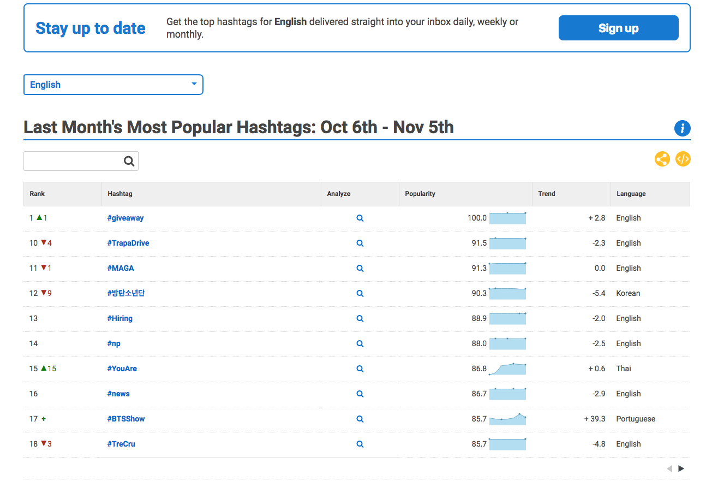
Helpful resource
www.hashtagify.me/

Slide 43
Setting up a group page
You must have a personal profile

Slide 46
Facebook for Business
A helpful portal for business page owners offering support for page creation, ad campaign management, and other platform resources.
You must sign –up separately for FfB, however, you will be able to link page roles once you have set-up
Analytics and insights

Slide 47
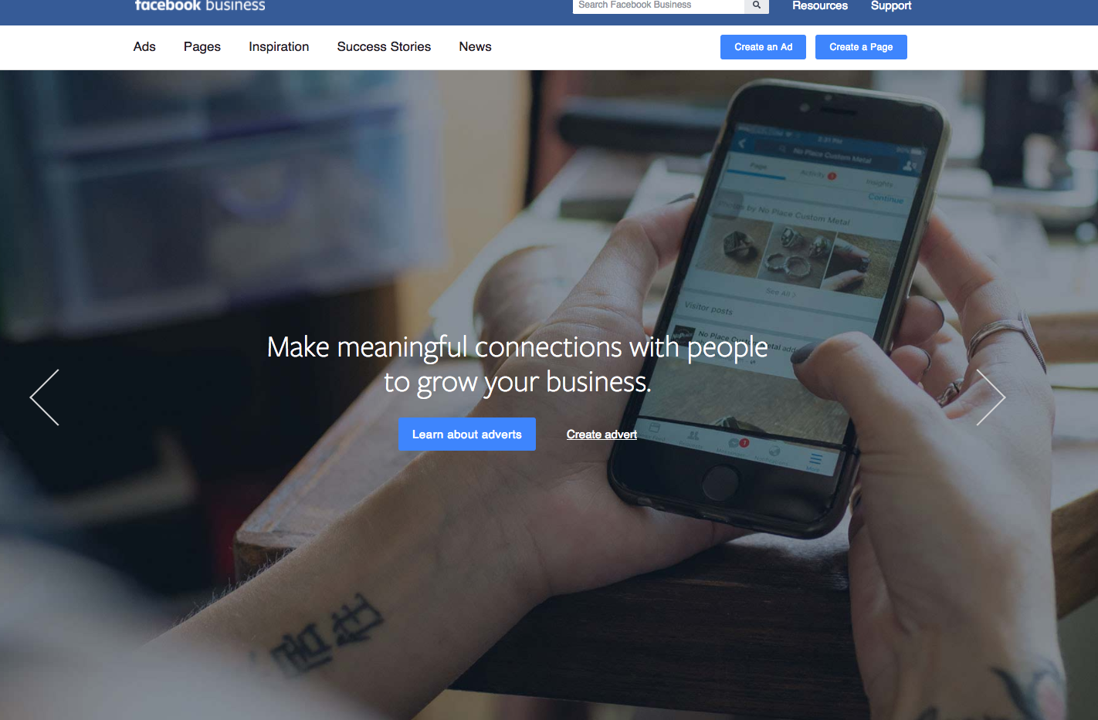

Slide 48
Questions?

