Slide 1
Social Media For All

Slide 2
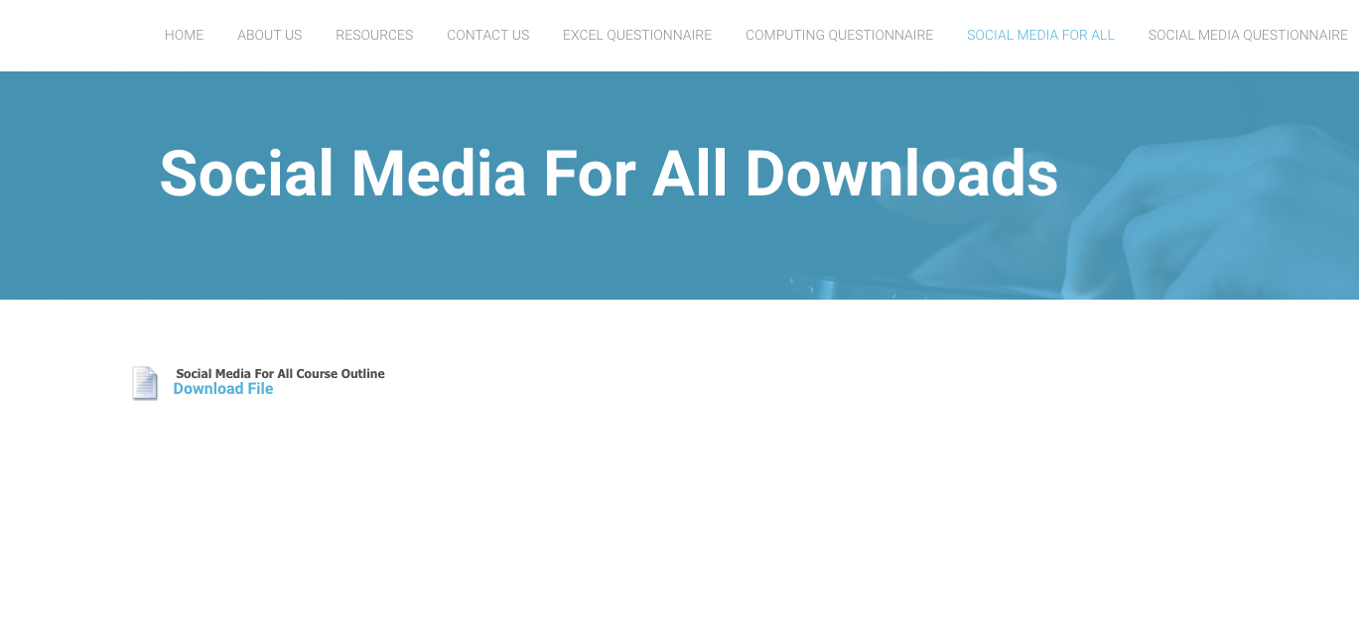
My name is Ashley Mackie
ashley@ashleymackie.com
Downloads are available here:
www.talentedmarketing.com/social-media-for-all

Slide 3
What is social media?
Social media is a way for people to communicate and interact online
Last decade has seen a surge in popularity
Users engage with (and around) it in a social context – conversations; commentary; user-generated content and engagement

Slide 4
User Generated Content (UGC)

Slide 5
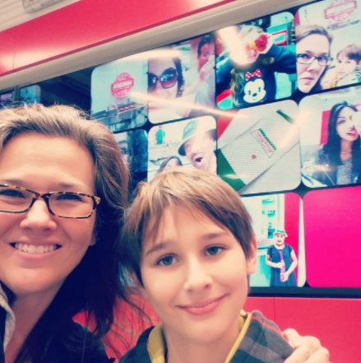
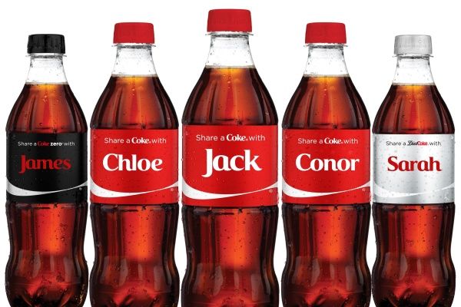
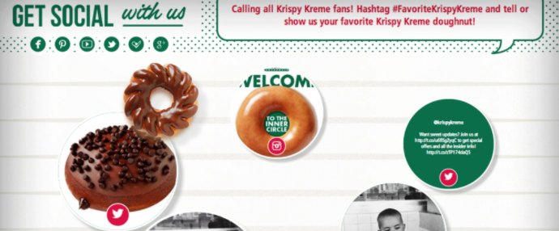
When you consider that 86% of millennials say that UGC is a good indicator of the quality of a brand, and that 68% of social media users between the ages of 18 and 24 take into account information shared on social media.
Notes:
Millennial 1981 – 1997

Slide 6
What is social media?
Non-technical web users are now able to easily create content on a rapidly growing number of platforms
For businesses – this brings oportunity and responsibility
Companies can grow lasting and scalable relationships with customer base

Slide 8
Why do we use social media?
To stay in touch with what friends are doing (36%)
To stay up-to-date with news and current events
To fill up spare time
To find funny or entertaining content
To share opinions
To share photos or videos with others

Slide 9
Why do we use social media?
Because friends are already on social media
General networking with other people
To meet new people
To share details of everyday life

Slide 11
Why do companies use social media?
Gain valuable customer insights
Increase brand awareness and loyalty
Run targeted ads with real-time results
Generate higher conversion leadds
Increase website traffic
Look at competitors
Share content
Build relationships
It is FREE?

Slide 13
Over the next few weeks we will explore these areas more thoroughly when we look at LinkedIn, YouTube and Twitter

Slide 14
Facebook

Slide 15
When Facebook started in 2004, it was a bare-bones social network focused on connecting college students ‘The Face Book’
13 years and more than 1 billion active users later, Facebook has become the most widely-used social network to date and has shaped online interaction as we know it. From connecting distant friends and family members, to bridging the gap between brands and their communities, Facebook has taken the way we interact online to a whole new level.

Slide 17
Groups
Groups are user-created and have varying levels of
privacy and security, much like individual profiles. Users can organize groups around any topic or event they like.
From professionally relevant groups to those organized around special interests, such as nutrition, the variety is limited only by interest of the users. These groups have undoubtedly been a welcome and sticky addition to the platform over time.

Slide 18
Events
Events allow users to organize around a point in time.
Security here is fairly customizable, allowing for public, private, and somewhere-in-between events.
A key feature here is the baked-in ability to export your Facebook events to other calendars, no doubt increasing usage and reliance on this feature that blends users' personal and professional lives.

Slide 19
Business Pages
Business pages have been an evolutionary
product for Facebook. Over the years, they have taken
several different shapes, though they are fairly stable today.
Like other types of pages, the feature set is ever-evolving as
they add more to meet the needs of the marketers behind
the brand's efforts. Facebook has recently added more
features in terms of analytics, reporting, security, and
access, as well as increased the richness available to those
wishing to dive into Facebook advertising.

Slide 20
Facebook Messenger
Facebook Messenger is a new way to
combine email, instant messenger, and Facebook
messages.
As new stand-alone group message services
popped up throughout 2010 and 2011, Facebook clearly
saw an opportunity and acquired one of the more popular
group-messaging apps known as Beluga. They have since
re-branded this app as Facebook Messenger.
On iOS, Blackberry, and Android devices, this is a stand-alone app, but it also integrates across the Facebook app and web
experiences.

Slide 22
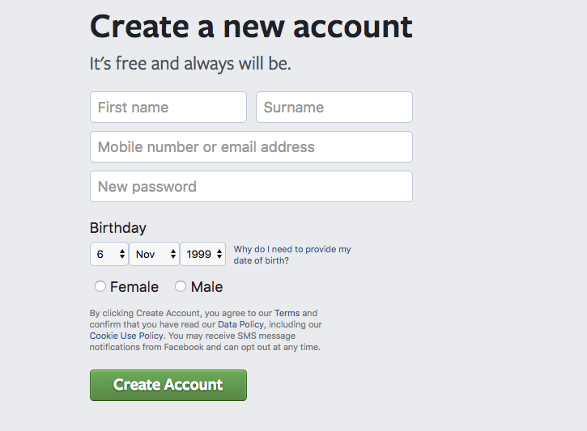
Setting up a new personal account
Go to https://www.facebook.com/r.php

Slide 25
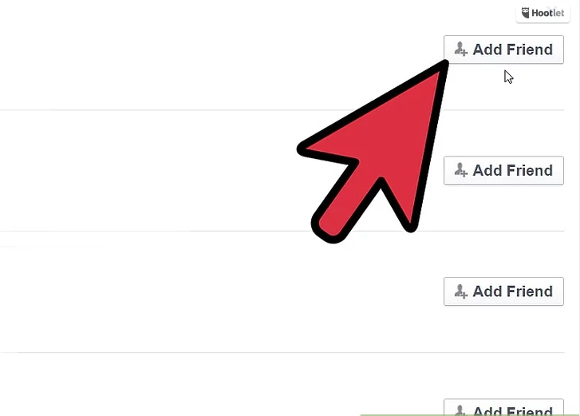

Slide 28
Posting

Slide 29
Best time of day to post on Facebook?

Slide 30
Hashtags
Hashtags turn topics and phrases into clickable links in your posts on your personal timeline or Page. This helps people find posts about topics they’re interested in. To make a hashtag, write #(the number sign) along with a topic or phrase and add it to your post. For example:
I just saw the cutest puppy! #dogs
When you click a hashtag, you’ll see a feed of posts that include that hashtag. You may also see some related hashtags at the top of the page.
Please keep in mind:
A hashtag must be written as a single word, without any spaces
You can include numbers in a hashtag, but punctuation and special characters (like $ and %) won't work
You can search for a hashtag using the search bar at the top of any page
You'll only see posts that were shared with you

Slide 31
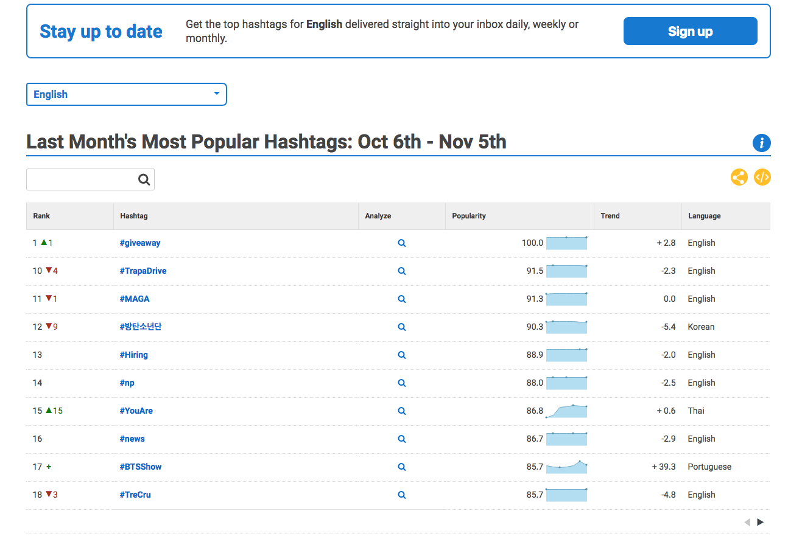
Helpful resource
www.hashtagify.me/

Slide 32
Setting up a group page
You must have a personal profile

Slide 35
Facebook for Business
A helpful portal for business page owners offering support for page creation, ad campaign management, and other platform resources.
You must sign –up separately for FfB, however, you will be able to link page roles once you have set-up
Analytics and insights

Slide 36
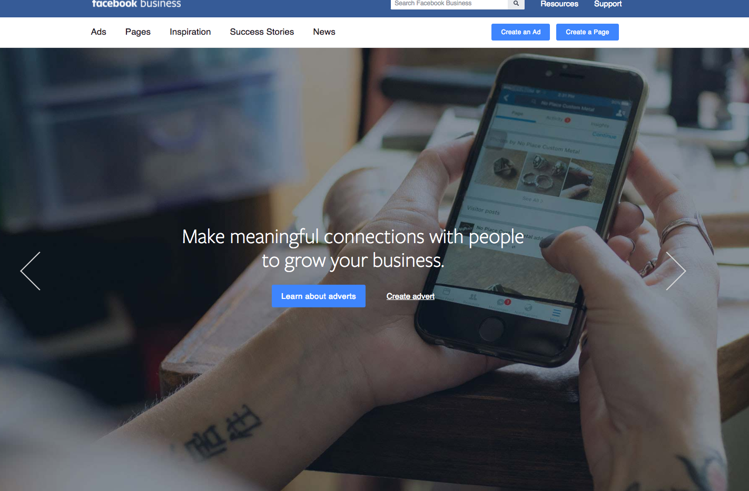

Slide 37
Questions?

Slide 38
Homework
Find Ashley Mackie and connect with her on Facebook
Find the new ‘Social Media for All 2017’ Facebook group
Tweak your Facebook profile and think about content and hashtags you should be using daily
Keep an eye out for any user generated content and take a photo!

