Slide 1
Hello!
Ashley Mackie – ashley@ashleymackie.com
www.talentedmarketing.com for downloads

Slide 2
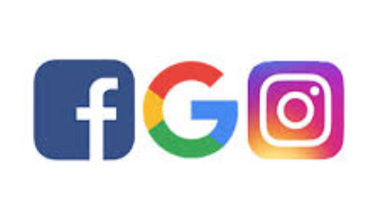
Social Media Advertising

Slide 3
Assignment recap?
Next Monday I will be here from 6pm…

Slide 4
Social advertising is advertising that relies on social information or networks in generating, targeting, and delivering marketing communications.

Slide 5
In 2017 Q1 more than 900 brands spend more than $130 million to advertise on Facebook, Instagram, Snapchat, Pinterest and LinkedIn

Slide 6
Many current examples of social advertising use a particular Internet service to collect social information, establish and maintain relationships with consumers, and for delivering communications.

Slide 7
Google, Instagram, and Facebook involve targeting and presenting ads based on relationships articulated on those same services.

Slide 8
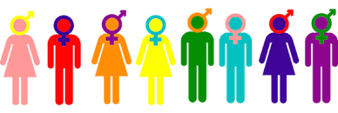
Demographics

Slide 9
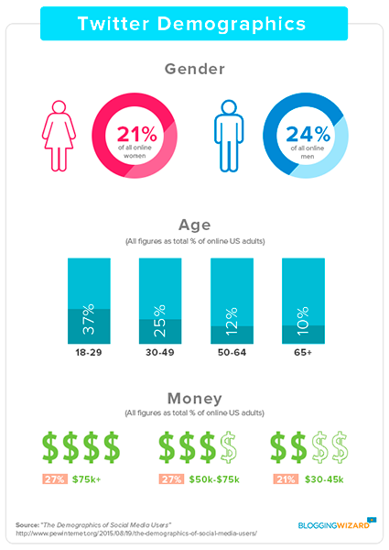

Slide 10
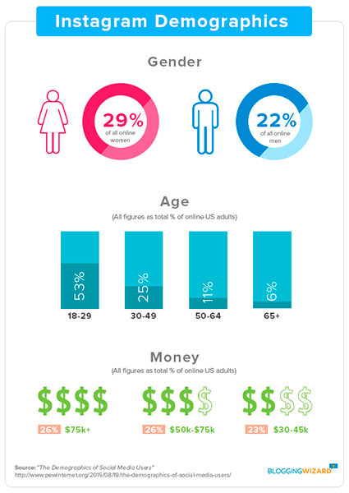

Slide 11
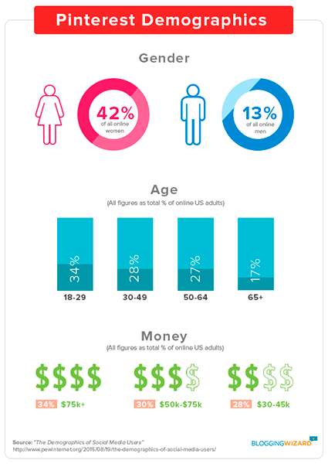

Slide 12
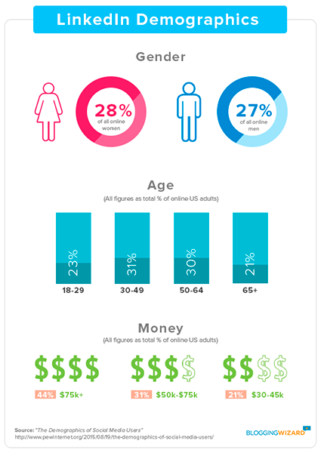

Slide 13
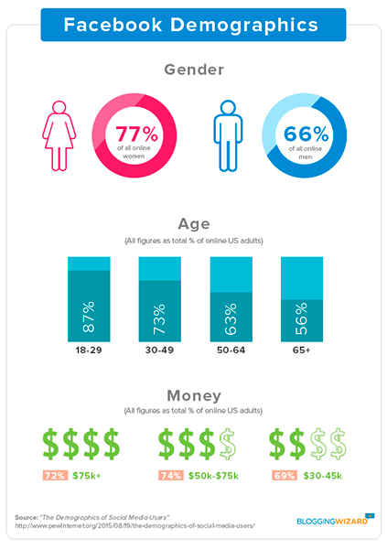

Slide 14
Here’s what you should take away from all these stats:
If you’re targeting younger users, stick to Instagram, Twitter and Snapchat.
If you’re targeting women with disposable income, head over to Pinterest.
For professionals with better education and income, use LinkedIn.
For everyone, go with Facebook or Google!

Slide 15
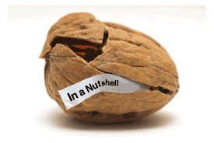
Currently Google, Instagram, and Facebook are the biggest platforms for targeting consumers in the UK.

Slide 16
According to an eMarketer study, 96% of social media marketers consider Facebook the most effective social media advertising platform.

Slide 17
Facebook Ads work both for B2C and B2B companies, and there are so many success stories that show more than 5x increases in marketing results after advertising on Facebook.

Slide 19
1. Facebook Advertising
Facebook is THE universal social media network.
With more than 2 billion monthly users, Facebook hosts over a quarter of the world’s population, providing advertisers with an unparalleled opportunity to reach virtually anyone and everyone.
Where Facebook Advertising Shines
When it comes to ecommerce, Facebook excels at lead generation.
If you want email addresses, Facebook is the place to go, with many advertisers reporting costs below $1 per lead.
The most common model used is to run a Facebook ad directly into a high-converting landing page offering some variety of a free lead magnet or bundle product.
When it comes to ecommerce, Facebook excels at lead generation.
If you want email addresses, Facebook is the place to go, with many advertisers reporting costs below £1 per lead – a great ROI
The most common model used is to run a Facebook ad directly into a high-converting landing page offering some variety of a free lead magnet or bundle product.

Slide 21
1. Facebook Advertising
Facebook is THE universal social media network.
With more than 2 billion monthly users, Facebook hosts over a quarter of the world’s population, providing advertisers with an unparalleled opportunity to reach virtually anyone and everyone.
Where Facebook Advertising Shines
When it comes to ecommerce, Facebook excels at lead generation.
If you want email addresses, Facebook is the place to go, with many advertisers reporting costs below $1 per lead.
The most common model used is to run a Facebook ad directly into a high-converting landing page offering some variety of a free lead magnet or bundle product.
Common content ‘sweetners’ for advertising Facebook campaigns:
Whitepapers
Ebooks
Product vouchers
Sitewide discounts
Limited-time offers
Giveaways
Free shipping

Slide 22
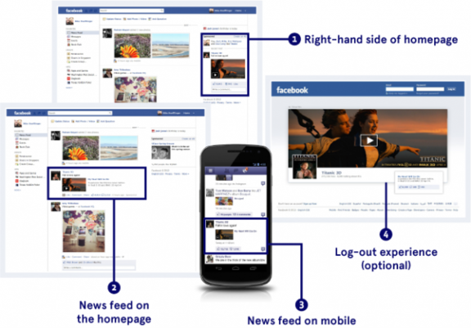

Slide 24
How do I create a Facebook ad?
You can create a Facebook ad using ad creation in Ads Manager
To do this:
From Ads Manager, click Create Campaign.
Choose an advertising objective. For example, if you want to create an ad to increase traffic to your website or get more people to download your app, select Traffic under the Consideration column. Learn more about choosing advertising objectives.

Slide 25
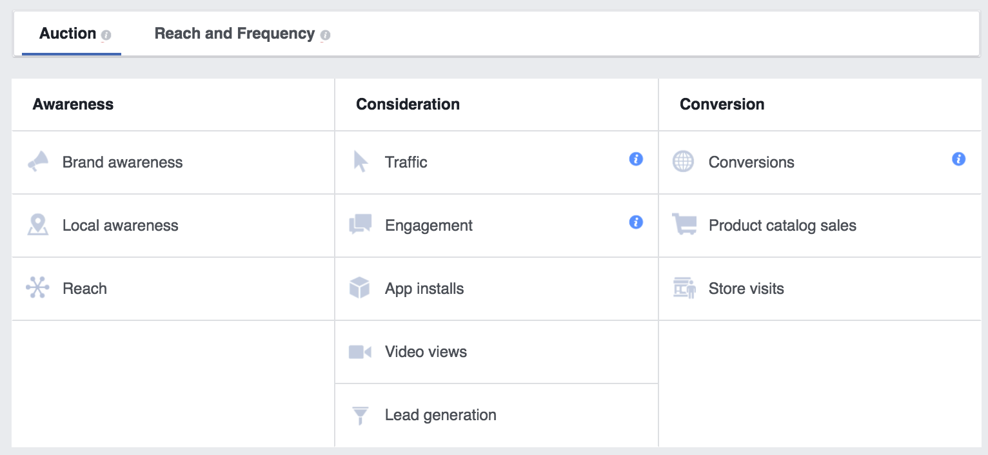

Slide 26
Click Continue. In the next steps, you can choose to advertise your Page, business, website, or event and then choose the audience, budget, images and text for your ad before placing your order.
How should your story be told?
Whether you want to use video, photo or text – or a combination of those elements – there's a Facebook advert format for every story. Our advert formats put your business goal front and centre, and they look great on every device and connection speed.

Slide 27
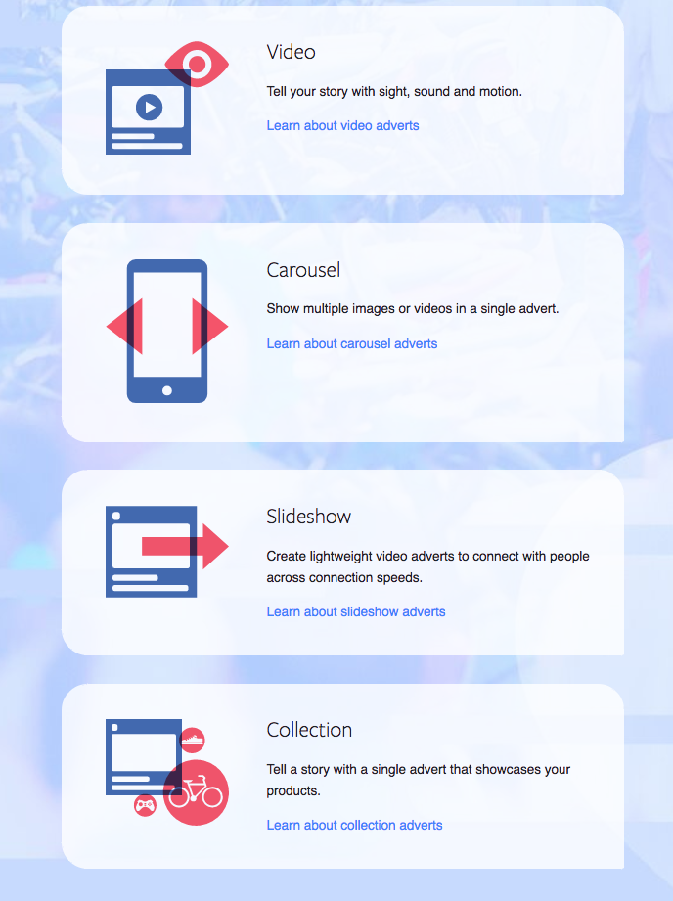

Slide 28
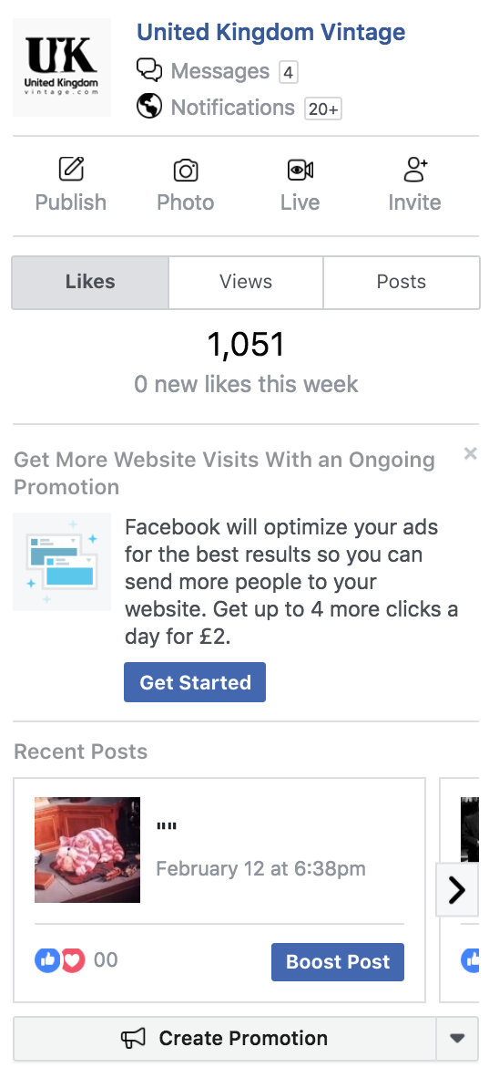

Slide 32
5 tips…

Slide 33
Facebook Marketplace

Slide 34
5 tips…

Slide 36
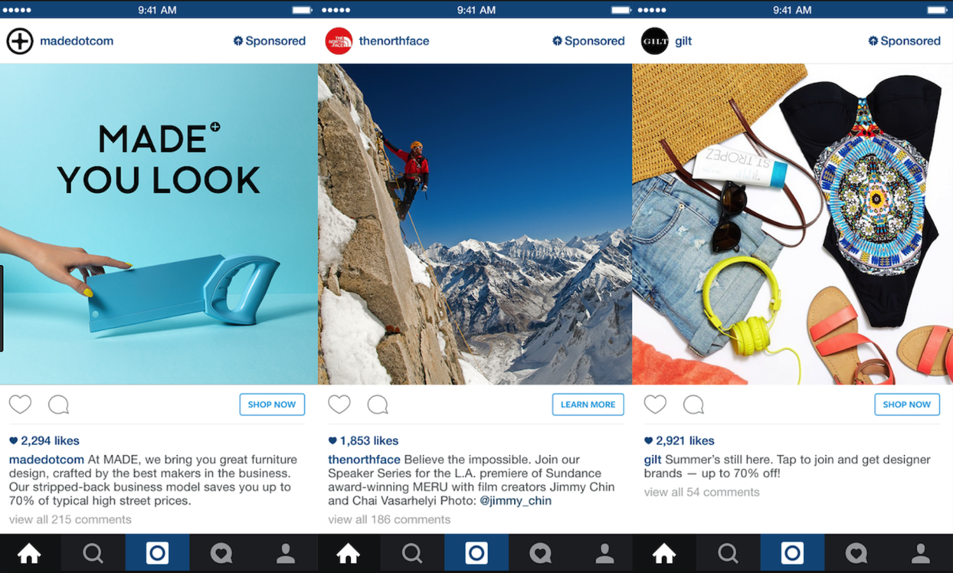

Slide 37
Instagram Ads work on the same system as Facebook Ads.
Costs depends on a few factors including your budget and whether you select Manual or Automatic bidding.
An Instagram Ad will never cost you more than you have to spend, though. If you have a budget of £10 per day, Instagram Ads will never cost you more than £10 a day.

Slide 38
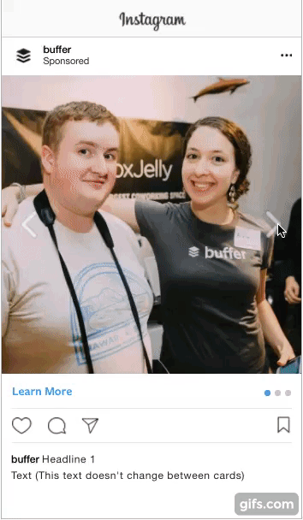
Types of Ads Available
Carousel Ads -

Slide 39
Carousel ads are ads with two or more scrollable images or videos.
Next, fill up the text field with the caption you want for your Instagram ads. This caption will remain the same even when a person scrolls through your carousel ad.
Carousel ad text
The next step is to create the cards of your carousel ad. You can create up to 10 cards in a single ad. For each card,
Upload an image, video, or slideshow (The specifications are all provided there.)
Fill in the headline (This text will form the first line of your caption and will change as a person scrolls through your carousel ad. See the example above.)
Leave the description blank (I believe this is for Facebook carousel ads.)
Fill in the destination URL (This is the URL behind your call-to-action button).
There are also some settings for the entire carousel ad.

Slide 40
Ignore the See More URL and See More Display URL fields (They are for Facebook carousel ads which have an end card.)
Select the most appropriate call-to-action button (This will be the same for every card of the carousel ad.)
Carousel ad cards
Tip: Facebook has a great resource and FAQ site for carousel ads. There are examples, best practices guides, design recommendations, and more.

Slide 41
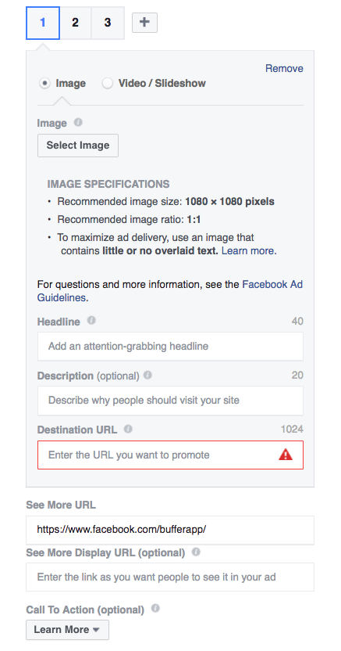

Slide 42
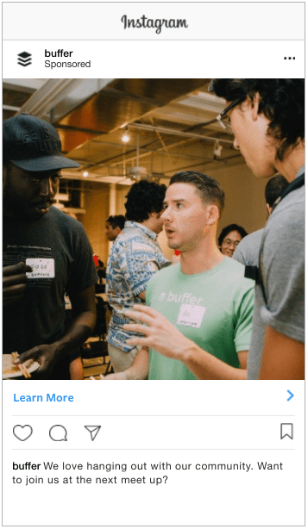
Single Image Ad

Slide 43
Then, the main field to fill up is the text field (i.e. your caption for the ad). The caption may include up to 300 characters but note that characters after the third line will be truncated into an ellipsis (“…”). Facebook recommends using 125 characters.

Slide 44
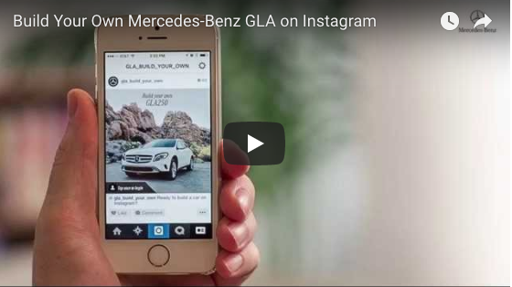
Picture and Interactive Navigation

Slide 45
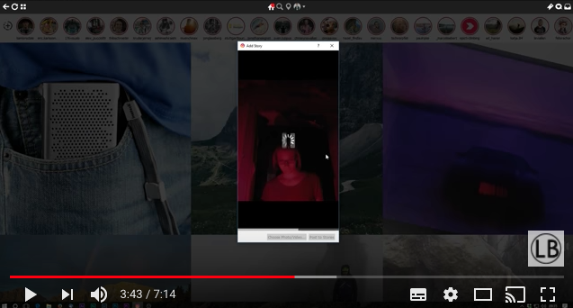
30 Second Video Ad – Instagram stories…

Slide 46
In late 2015, Instagram opened up Instagram ads. Using the Facebook advertising system, marketers can now reach any specific segment of Instagram’s 600+ million users.

Slide 47
And with 400 million people using Instagram every day, Instagram ads have become an enticing avenue for brands looking to increase engagement (and profits, too).

Slide 48
Choose a marketing objective
Name your ad campaign(Some marketing objectives require additional steps here, which we’ll go through below.)
Define your audience, placements, budget, and schedule
Create the ad itself or use an existing post

Slide 50
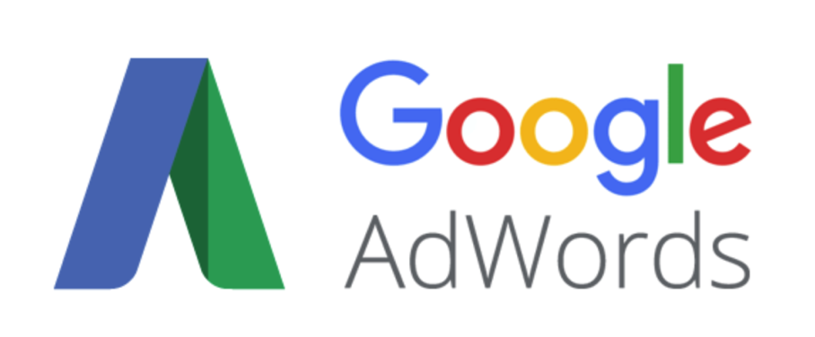

Slide 51
The current Google landscape
Did you know that every day Google processes over 40k search queries every second?
This equals to over 3.5 billion searches per day and 1.2 trillion searches per year worldwide.
Notes:
What if this Google Adwords tutorial could help you attract a small part of the billions of searches done every day to your store? Imagine all the millions of people that could be interested in what you have to sell from all around the world, ready to buy from you.
You might be thinking, “well, but how do I do that? It must be crazy complicated to get all these people to my store and make them want to buy from me.”
It turns out that it’s not that hard to get all these millions of people to your store. You only need to follow the right steps.
In this Google Adwords tutorial, I will show you all the steps you need to take to create your first Google Adwords campaign so you can start getting visitors and increase your sales.

Slide 52
2016 v. 2017
Notes:
Top traffic refers – does everyone know what a online traffic referral is?

Slide 53
What is Google Adwords and how does it work?
Google Adwords is Google's own advertising service which allows you to place search results for your website on a search engine results page (SERP) by paying for them.
There’s no need to wait for your new website to work its way organically up the rankings.
By using paid search you can see immediate results and it’s not nearly as difficult to use or expensive as you may think.

Slide 54
This essentially is called Paid Search
Paid search is the term we use for advertising within the listings of a search engine.
These normally appear at the top of a SERP or to the side, and increasingly look more and more like organic results.
At the moment Google places a small green ‘Ad’ label on them.

Slide 55
Advertising costs are related to both the cost-per-click and the volume of clicks, which is directly related to the click-through-rate of the ad:
Advertising Costs = Costs Per Click * No. of Clicks
Advertising Costs = Costs Per Click * Click Through Rate
The effect of having a higher ad position greatly impacts on the overall costs for a keyword due to the increased click-through-rate combined with the high cost-per-clicks.

Slide 56
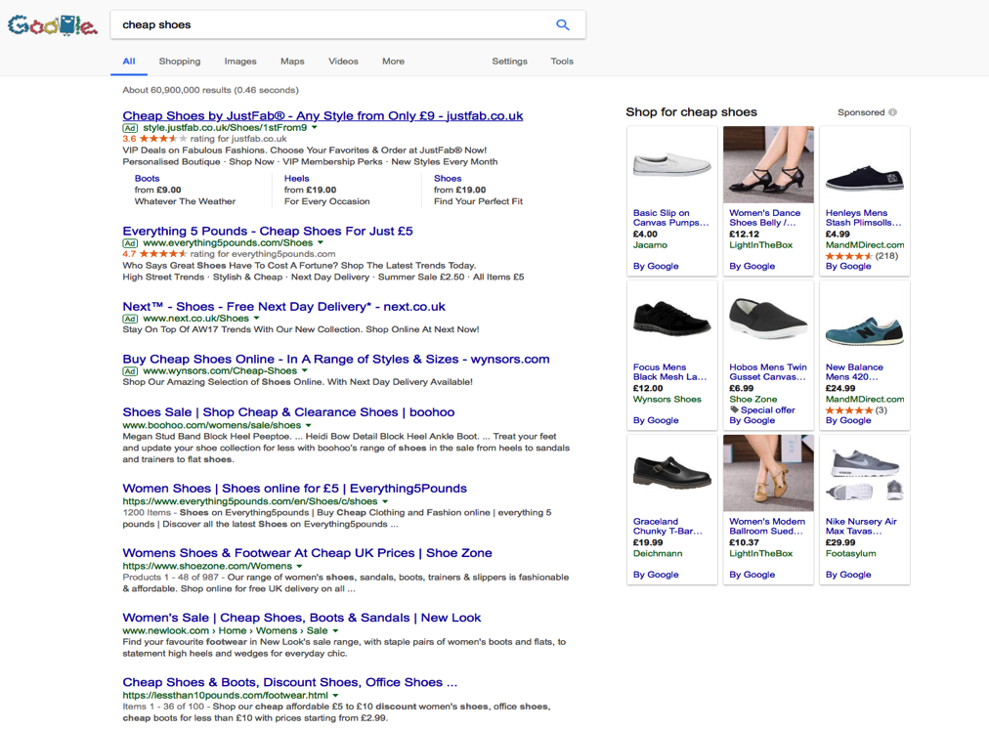
Cheap shoes...

Slide 58
Best position

Slide 59
Finance and Insurance leads

Slide 60
Set-up your account
Before we get started setting up a campaign, you need to have an Adwords account.
Create an account by using the below link
https://adwords.google.com/home/how-it-works/

Slide 61
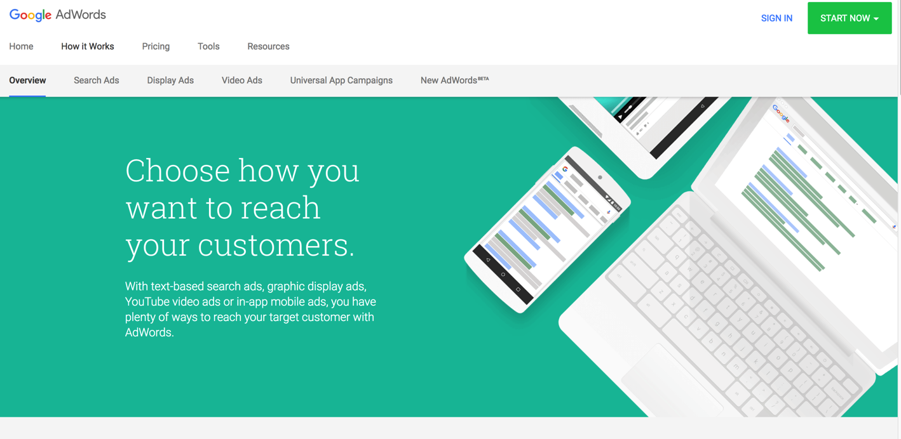

Slide 62
TIP
I would advise that you set-up a new and separate email account for each project/client
It keeps everything in place
Occasionally, Google will send you offers
Clients can inherit the account
This can tie in with Google Analytics – viewing traffic rates, etc

Slide 63
Remember!
Once you set up your account, you’ll likely start getting the occasional email from Google offering to “help” you by setting up your advertising for you. Accepting this offer is a common mistake that new advertisers make. The problem with this is that your objective is to maximise results (sales, leads, etc.) and minimise advertising spending, while Google’s objective is to maximise the amount of money that you spend on advertising.

Slide 64
Your campaign
The ultimate goal for any online business is to appear on the 1st page of the SERPS, essentially giving you free advertising.
But if you have a new business, it can easily take up to a year to organically reach page 1, even with good SEO. That’s why you’ll need to invest in pay-per-click advertising (Google Adwords) to get your first customers.

Slide 65
The objective
Sales / Purchases
Lead generation
Email sign-ups
User registrations
Increase brand awareness

Slide 66
Keywords
Proper keyword research and selection are crucial to the success of your Adwords advertising – if you don’t get this right you can be almost certain that your advertising won’t be profitable.
Building a Keyword List
1. Start With Your Website.
The best place to start building your keyword list will be your website, which will include the main terms that describe your business and its products/services.

Slide 67
Start with your own list of keywords

Slide 68
Being a sleuth with competitors
In Internet Explorer/Google, click on View > Source to see the HTML source code of the website.
You can then search for these tags to understand the keywords your competitors are using on their website. <title> – This tag is a headline description of the page and is the way Google displays your site in listings

Slide 69
TIP
Use the following website tool to see what competitors are doing with keywords:
https://www.found.co.uk/seo-tool/

Slide 70
Google Keywords Planner
Once you’ve put together a basic list of keywords for your business’ products/services, you can use the Google Keyword Tool to find related terms and phrases to develop a more complete list of possible keywords. This is important, because your customers may use different words and phrases when looking for your products/services.
Start by entering each of the keywords from your website into the tool, being sure that Location under Advanced Options is set to the country that you will be targeting. Also if you want to just select individual keywords make sure the ‘Keyword Ideas’ tab is selected.

Slide 71
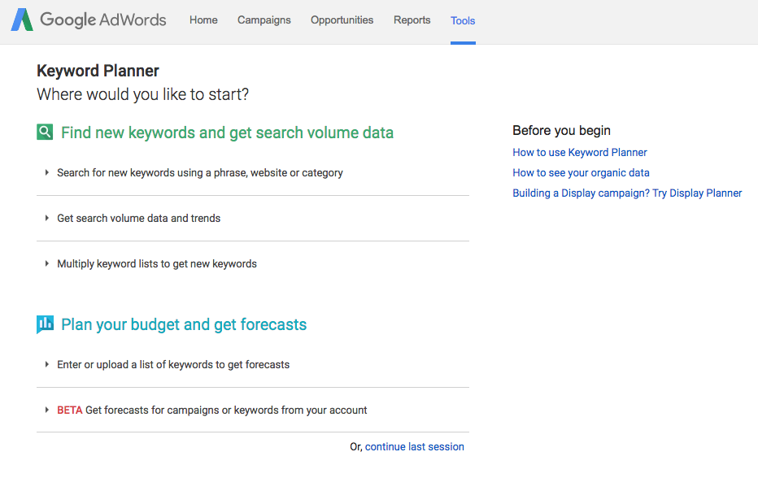

Slide 72
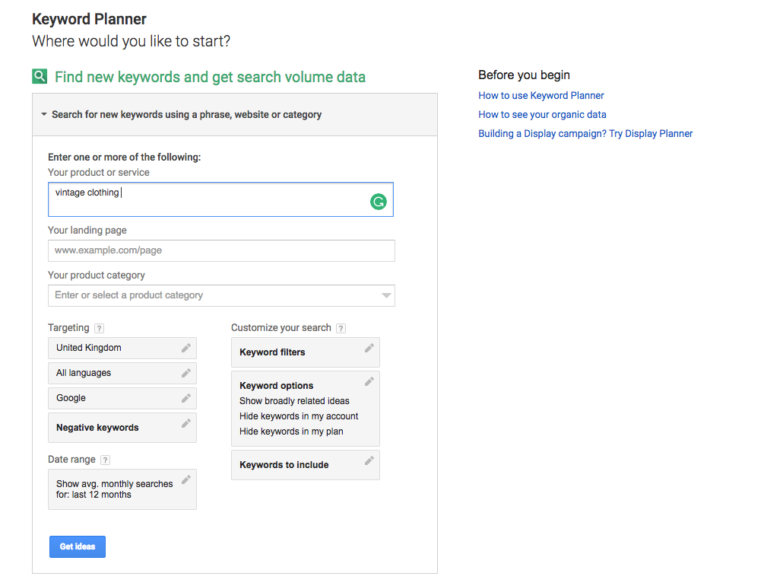

Slide 74
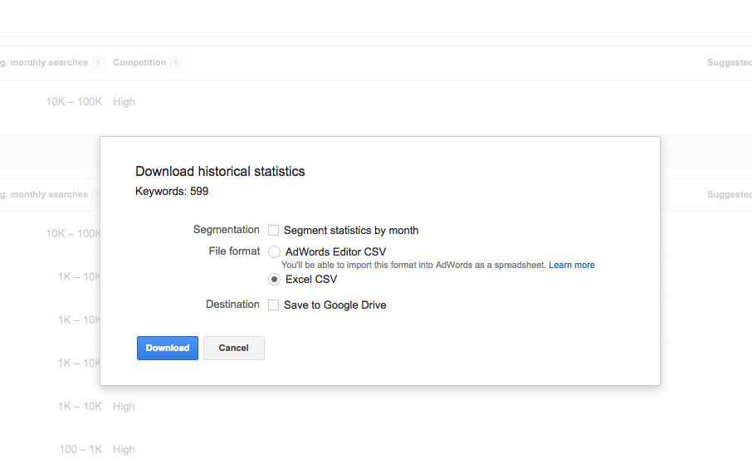

Slide 76
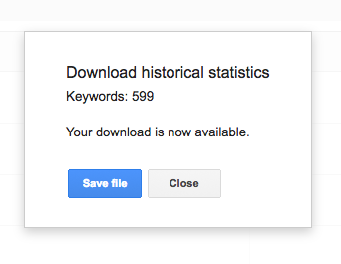

Slide 77
Remember!
One of the biggest mistakes that new advertisers make is throwing any and all semi-relevant keywords into their account, on the basis that more keywords will result in more visitors and sales.
There are a couple of reasons why you don’t want to do this:

Slide 78
Cost
If you’re using Adwords for the first time you probably have a limited advertising budget (if you don’t, you should, at least until you have proven that Adwords is a profitable advertising medium for your business).
In general, the more keywords you have in your account, the more you’ll spend on advertising. It therefore makes sense to start with a smaller number of keywords that are most relevant to your business and most likely to be profitable, and then expand your keyword list

Slide 79
Quality Score
Despite its importance, Quality Score is often one of the most difficult concepts to for new Adwords advertisers to understand. Essentially, the higher your Quality Score (on a scale of 1 to 10), the less you will have to pay per click for your ad to appear in a certain position on the search results page.
It’s therefore possible for an advertiser with an ad in the first position on the page to be paying less than a competitor in position 2, because of higher Quality Score.

Slide 80
Relevance
How relevant is the keyword to the products/services that your business offers? The keyword “woman’s vintage dress” would be a better choice than the more general keyword “woman’s shoes”, which would likely be used by some people searching for products that their business doesn’t offer.

Slide 81
Search volume
While it’s important to focus on targeted keywords that are highly relevant to your business, you also need to strike a balance with search volume – how many people are actually searching for the keyword on Google. Generally, the more targeted a keyword is, the lower its search volume.
Cost
How much will you have to pay each time someone clicks on your ad after searching for this keyword? While not particularly accurate, the Keyword Tool’s Approximate CPC gives you some idea of how expensive a keyword is.
Choosing keyword match types
You’d think that by now we’d be done with keywords. Not quite. For each keyword in an Adwords account, a “match type” must also be chosen, which controls which search queries are eligible to trigger your ad. Correct match type selection can be the difference between a highly profitable Adwords account, and one that wastes money.

Slide 82
Broad match
Broad match is the default option in Adwords, and allows you to reach the largest number of people, but provides the least control over when your ads are shown. For example, if you use the keyword “mens shoes”, your ad will be displayed to people searching for “mens shoes”, “shoes for men online”, and potentially a whole variety of irrelevant search queries such as “brown shoe polish”.
Phrase match
Phrase match provides more control than broad match, but reaches a smaller audience. For a phrase match keyword to display your ad, someone must enter a search into Google that contains your keyword in the same order that you typed it. For example, for the phrase match keyword “mens shoes”, your ad would be displayed to people searching for “mens shoes”, “cheap mens shoes” or “leather mens shoes henley”.

Slide 83
How many campaigns do I need?
There’s a number of reasons why you might want to create multiple campaigns. These include separating advertising based on:
Different products or services
Different budgets
Geographical location
Network (this guide focuses only on the Search Network, however when using the Display Network you should always use separate campaigns)
How many ad groups do I need?
Within each campaign, you’ll need to create at least one ad group, which is a collection of keywords and ads. As a general rule, you should aim for at least three ad groups per campaign.

Slide 84
Writing compelling ads
Ok, we’re ready to start writing some ads. While a complete guide to ad copywriting is beyond the scope of this guide, there are a few things you should keep in mind when writing your ads:
Know your USP
Your USP, or Unique Selling Proposition, explains why a prospective customer should buy your product or service instead of a competitor’s. Including this in your ad will differentiate it from all of the other ads/search results around it.
Think like the searcher
Try to put yourself in the position of someone searching for one of your keywords in Google. What do they want to know about your product/service? What might their objections or concerns be? Answer these questions in your ad if you can.
Include your keyword
Ads that include the keyword, especially in the heading, tend to receive more clicks than ads that don’t. One reason for this is that when a keyword is included in ad text, Google highlights those words in bold, making it more eye-catching.
Include a call to action
A Call To Action tells the searcher what you want them to do once they arrive on your site. For an ecommerce website, this might be “Buy Online Now”. This also helps to filter out people who aren’t going to take the action that you require.

Slide 85
Writing compelling ads
Ok, we’re ready to start writing some ads. While a complete guide to ad copywriting is beyond the scope of this guide, there are a few things you should keep in mind when writing your ads:
Know your USP
Your USP, or Unique Selling Proposition, explains why a prospective customer should buy your product or service instead of a competitor’s. Including this in your ad will differentiate it from all of the other ads/search results around it.
Think like the searcher
Try to put yourself in the position of someone searching for one of your keywords in Google. What do they want to know about your product/service? What might their objections or concerns be? Answer these questions in your ad if you can.
Include your keyword
Ads that include the keyword, especially in the heading, tend to receive more clicks than ads that don’t. One reason for this is that when a keyword is included in ad text, Google highlights those words in bold, making it more eye-catching.
Include a call to action
A Call To Action tells the searcher what you want them to do once they arrive on your site. For an ecommerce website, this might be “Buy Online Now”. This also helps to filter out people who aren’t going to take the action that you require.

Slide 86
Ad rules
If your ad doesn’t meet Google’s rules, it will be disapproved. These include ad formatting rules and Google’s general advertising policies.
Setting up conversion tracking
Access to proper metrics is essential to managing your Adwords account – without them there is no way of knowing if you are achieving your goals, or which advertising (campaigns, ad groups and keywords) is profitable and which are not.
Adwords conversion tracking tool provides important data relating to what a searcher does after clicking on your ad (whether they purchase, submit an enquiry via a contact form, etc.), which allows you to make advertising decisions based on what is actually getting results.
Once you’ve add conversion tracking, you’ll have access to the following metrics:
Cost Per Conversion (how much are you paying for a sale, phone call, etc.)
Conversion Rate (what percentage of visitors are completing a transaction, contacting you, etc.)

Slide 87
Total Conversions (total number of transactions, phone calls, etc.)
Once you have conversion tracking installed, you’ll be able to easily identify where you’re getting results and where you’re not, and then make changes accordingly. Without it, you’re essentially “flying blind”, almost certainly wasting money as a result.
We’ve worked with clients who have wasted thousands of dollars on Adwords (before hiring us) that could have been easily avoided had they been using conversion tracking.
In order to use the Adwords conversion tracking, you’ll need to add a piece of code to your website.
https://support.google.com/adwords/answer/1722054?hl=en

Slide 89
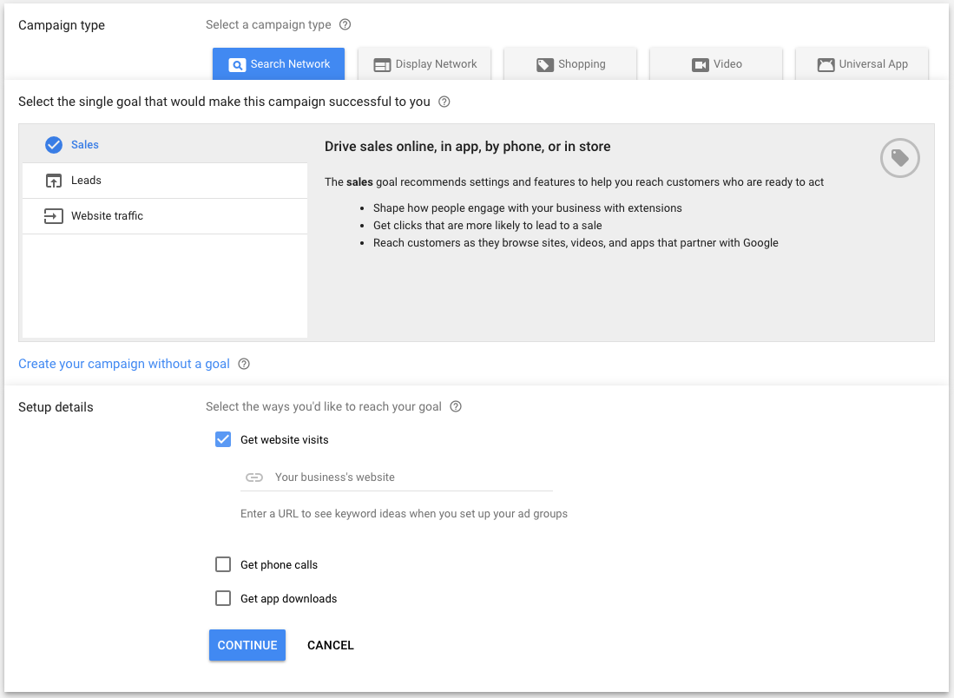

Slide 92
Headline
People are most likely to notice your headline text, so consider including words that people may have entered in their Google search. Your text ad consists of two headlines where you can enter up to 30 characters in each to promote your product or service. The headlines are separated by a dash "-" and may appear differently based on the device someone is using when they view your ad.
Display URL
The display URL, usually in green, shows your website address. This display URL is made up of the domain from your final URL and the text in the optional ”Path” fields. These fields are designed to help people who see your ad get a better sense of where they’ll be taken when they click it. Your path text doesn’t have to match the exact language of your display URL.

Slide 93
Description
Use the description to highlight details about your product or service. It’s a good idea to include a “call to action” – the action you want your customer to take. If you’re an online shoe shop, your description might include “Shop now” or “Buy shoes now”. If you offer a service, you might want to add something like “Get an instant quote online” or “See pricing”.
Length limits
Field Max length
Headline 1 30 characters
Headline 2 30 characters
Description 80 characters
Path (2)* 15 characters each
In expanded text ads, the length limits are the same across all languages. Each character in double-width languages like Korean, Japanese or Chinese counts as two towards the limit instead of one.

Slide 94
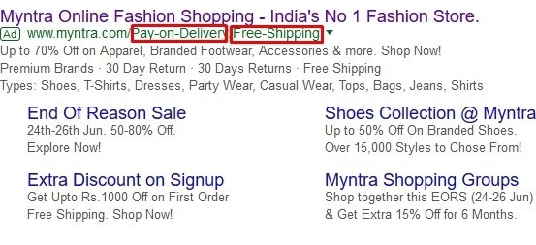
*The “Path” fields are part of the Display URL in expanded text ads, which is typically displayed in green text below the headline and above the description. The fields give potential customers an idea of where they will end up on your site once they have clicked your ad, so the text you put in the fields should describe the product or service described in the ad in more detail. Paths are optional, and they support up to 15 characters each.
AdWords uses the domain from your final URL combined with your path text, if any is entered, to create the Display URL.

Slide 95
Sign in to your AdWords account.
Click the Tools tab and select Ad Preview and Diagnosis.
In the text box, enter the keyword that you want to test. Make sure it’s a keyword that’s included in your campaign, or closely related.
Change any of the other settings (location, language, device) as needed. If you’ve targeted your ad to a certain language, location or device, you’ll need to specify this information to preview your ad.
Click Preview.
Ad Preview and Diagnosis tool

Slide 96
Sign in to your AdWords account.
Click the Tools tab and select Ad Preview and Diagnosis.
In the text box, enter the keyword that you want to test. Make sure it’s a keyword that’s included in your campaign, or closely related.
Change any of the other settings (location, language, device) as needed. If you’ve targeted your ad to a certain language, location or device, you’ll need to specify this information to preview your ad.
Click Preview.
The tool will tell you if your ad is eligible to appear for these search settings. If your ad is eligible to show on the first page of Google search results, you’ll see it highlighted in green. Ads that are eligible and show on the 2nd page or later may not appear in the Ad Preview and Diagnosis tool. Bear in mind that if your ad has extensions, they may not always display in the Ad Preview and Diagnosis tool. View your ad extension performance.

Slide 97
1) AdWords launched in 2000, when searchers were conducting more than 20 million searches per day on google.com. Sixteen years later, the search engine handles more than three billion searches per day. (Search Engine Land)
2) An 18-year-old college dropout named Scott Banister is credited with the brilliant, multi-billion-dollar idea of pay-for-placement search listings, an idea later developed by Bill Gross at IdeaLab. (Search Engine History)
3) AdWords was actually Google’s second advertising program. The first, called Premium Sponsorships, launched just months before. After a few years, AdWords overtook it. (Search Engine Watch)
The Numbers of Today
4) Number of Google Advertisers: Over 4 million (Business Insider)
5) Google’s takes up 33% of global digital ad revenue (Emarketer)

Slide 98
6) About 97% of Google’s total revenue comes from advertising. (Investopedia)
7) Businesses make an average of $2 in revenue for every $1 they spend on AdWords. (Google Economic Impact)
8) The top 3 paid ad spots get 41% of the clicks on the page (Niel Patel)
9) AdWords competitive rate of 87% allows your advertisement to fairly promote your products or services making you a competitor to those in similar industries. (Optimus 01)
Google’s Display and Search Network

Slide 99
10) Number of businesses advertising on the Google Search Network: Over 1.2 million (Wordstream)
11) Number of sites that are part of the Google Ad Display Network: Over 1 million (Wordstream)
12) Google’s display campaigns reach 80% of global internet users (Google Content Network)
13) Consumers exposed to display ads are, on average, 155% more likely to search for brand- and segment-specific terms. (Google Content Network)
14) The average click-through rate of an ad on the Google Display Network is four times as high as the average banner ad in the US and almost ten times as high as a Facebook ad. (Moz)
AdWords Industry Superlatives

Slide 100
15) The most expensive keyword to advertise with Adwords is…’Insurance’ at about $55 per click. (Media Vision Interactive)
16) Dating & Personals industry have the lowest average Cost Per Actions: $6.91 (Search Engine Land)
17) The Legal industry has the highest average Cost Per Actions: $135.17 (Search Engine Land)
18) Industry with the best average conversion rate for AdWords search ads: Insurance and Finance (7.19%) (Search Engine Land)

Slide 101
19) Industry with the best average conversion rate for AdWords display ads: Home Goods (2.19%) (Search Engine Land)
‘Cause We Are Living In A Mobile World
20) 70% of mobile searchers call a business directly from Google Search (AdWords Blog)
21) 33% of all Google search clicks are generated through mobile (Merkle Inc.)
22) There are at least 300,000 mobile apps currently serving Google Mobile Ads (Protocol 80)

Slide 102
Further reading:
https://brianclifton.com/blog/2013/08/20/calculating-your-real-roi-adwords/
https://www.crazyegg.com/blog/successful-adwords-ads/
https://www.upwork.com/hiring/community/successful-adwords-campaign/

Slide 103
Outside of Adwords
When you consider that 95% of your visitors will not make a purchase when they visit your site for the first time, it demonstrates the value of nurturing a relationship of trust.
That means acquiring a visitor’s email, usually in exchange for something such as a free e-book or download. This method is called a ‘lead magnet’ (a.k.a. opt-in bribe) that marketers use to obtain email addresses and then feed potential customers with bi-weekly emails full of useful content.

Slide 104
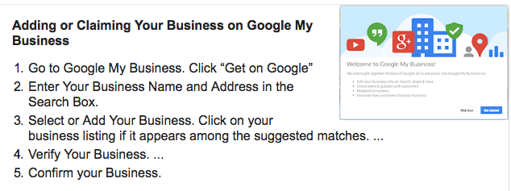
Is your company on Google (& Maps)?
https://www.google.com/business/

Slide 105
Questions?
Ashley Mackie – ashley@ashleymackie.com
Social Media For All – Social Media Advertising 4/12/2017 – FREE Tester session?
www.talentedmarketing.com for downloads

