Slide 2
My name is Ashley Mackie
ashm@henleycol.ac.uk
Downloads are available here:
www.talentedmarketing.com
Contact Toni O’Toole for details on enrolment: toto@henleycol.ac.uk

Slide 3
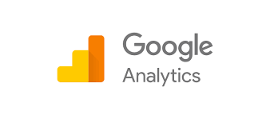

Slide 4
Social Media

Slide 5
What is social media?
Social media is a way for people to communicate and interact online
Last decade has seen a surge in popularity
Users engage with (and around) it in a social context – conversations; commentary; user-generated content and engagement

Slide 6
What is social media?
Non-technical web users are now able to easily create content on a rapidly growing number of platforms
For businesses – this brings opportunity and responsibility
Companies can grow lasting and scalable relationships with customer base

Slide 8
Why do we use social media?
To stay in touch with what friends are doing (36%)
To stay up-to-date with news and current events
To fill up spare time
To find funny or entertaining content
To share opinions
To share photos or videos with others

Slide 9
Why do we use social media?
Because friends are already on social media
General networking with other people
To meet new people
To share details of everyday life

Slide 11
Why do companies use social media?
Gain valuable customer insights
Increase brand awareness and loyalty
Run targeted ads with real-time results
Generate higher conversion leads
Increase website traffic
Look at competitors
Share content
Build relationships
It is FREE

Slide 13
Websites

Slide 15
What to consider
Get Your Domain Name
Choose a Web Host and Sign Up for an Account
Do you need a website (e-commerce) or a blog?
Drafting content using quality content and keywords
Designing your Web Pages
Going Live
Management

Slide 16
Google Analytics and Keywords

Slide 17
The current Google landscape
Did you know that every day Google processes over 40k search queries every second?
This equals to over 3.5 billion searches per day and 1.2 trillion searches per year worldwide.

Slide 18
Top Traffic Referrers 2016 v. 2017

Slide 19
Google hasn't offered an update in years, but estimates suggest as many as 30–50 million websites use Google Analytics.

Slide 20
Do you have a blog?
Do you have a website?
If the answer is yes, whether they are for personal or business use, then you need Google Analytics.

Slide 21
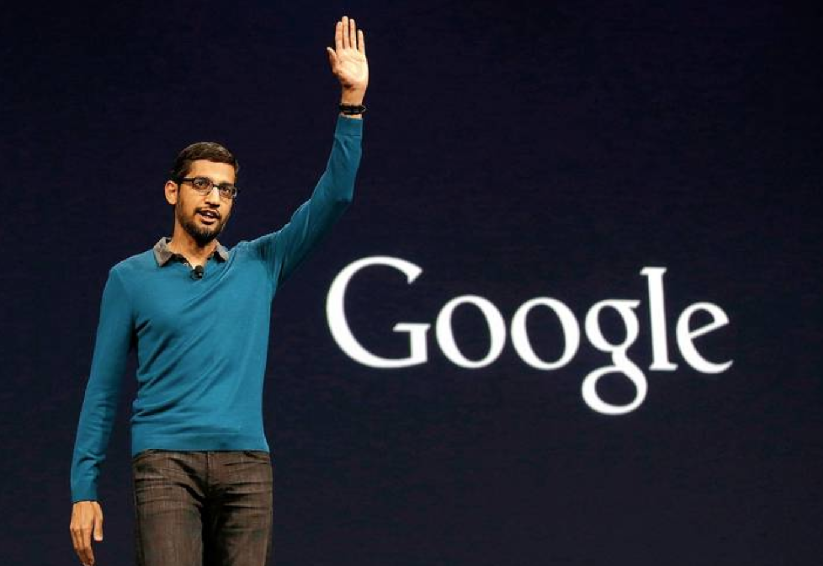
How many people visit my website?
Where do my visitors live?
Do I need a mobile-friendly website?
What websites send traffic to my website?
What marketing tactics drive the most traffic to my website?
Sundar Pichai, Google CEO

Slide 22
Which pages on my website are the most popular?
How many visitors have I converted into leads or customers?
Where did my converting visitors come from and go on my website?
What blog content do my visitors like the most?

Slide 23
Customisation

Slide 24
Real Time

Slide 25
Goals

Slide 26
Microsoft Office

Slide 27
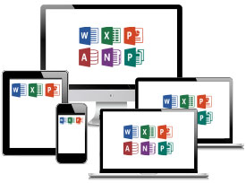

Slide 28
Examples of what is covered
Basic
Mail merge – Excel and Word
Presentations – PowerPoint
IF Function
LookUp, IF and VLOOKUP Function
Track Changes
Pivots
Formulas

Slide 29
Get Published on

Slide 30
You don’t have to be a professional writer… or have been previously published… or have any internet business experience at all to start with Amazon self-publishing.
Anybody can use this platform to get their work out into the world and into the hands of waiting audiences.

Slide 31
According to Author Earnings, there were over 485 million eBooks sold on Amazon by 20,000 unique publishers.

Slide 32
This program has several advantages:
You can upload your book on the platform in just a few minutes. And your book will be on sale in a couple of days at most.
You retain the rights to your books and can set your own prices.
For every book sold, you get to keep 70 percent of the sale price. Amazon keeps the rest.
You can make changes to your book and upload changes at any time.

Slide 33
What eBooks sell on Amazon
Formatting for Kindle
Cover Design
The Dashboard
Marketing Books - cost-effectively and through social media, blogs and websites

Slide 34
Finally…

Slide 35
www.talentedmarketing.com

Slide 36
Questions?

