Slide 1
Keywords for Social Media
By tracking keyword trends on the mighty Google it helps with looking at keywords that could help with hashtags and content ideas on social media. Many SEO agencies argue that social media SEO can help improve fundability and ranking position
Building a Keyword List
1. Start With Your Website.
The best place to start building your keyword list will be your website, which will include the main terms that describe your business and its products/services.

Slide 2
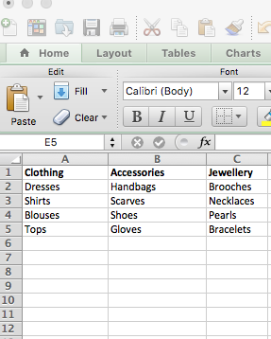
Start with your own list of keywords

Slide 3
Being a sleuth with competitors
In Internet Explorer/Google, click on View > Source to see the HTML source code of the website.
You can then search for these tags to understand the keywords your competitors are using on their website. <title> – This tag is a headline description of the page and is the way Google displays your site in listings

Slide 4
TIP
Use the following website tool to see what competitors are doing with keywords:
https://www.found.co.uk/seo-tool/

Slide 5
Google Keywords Planner
Once you’ve put together a basic list of keywords for your business’ products/services, you can use the Google Keyword Tool to find related terms and phrases to develop a more complete list of possible keywords. This is important, because your customers may use different words and phrases when looking for your products/services.
Start by entering each of the keywords from your website into the tool, being sure that Location under Advanced Options is set to the country that you will be targeting. Also if you want to just select individual keywords make sure the ‘Keyword Ideas’ tab is selected.

Slide 6
In order to use the Google Keyword Planner, you’ll need to have a Google Adwords account.
If you don’t have one already, you can set one up quickly if you have a gmail account.
https://adwords.google.com

Slide 7
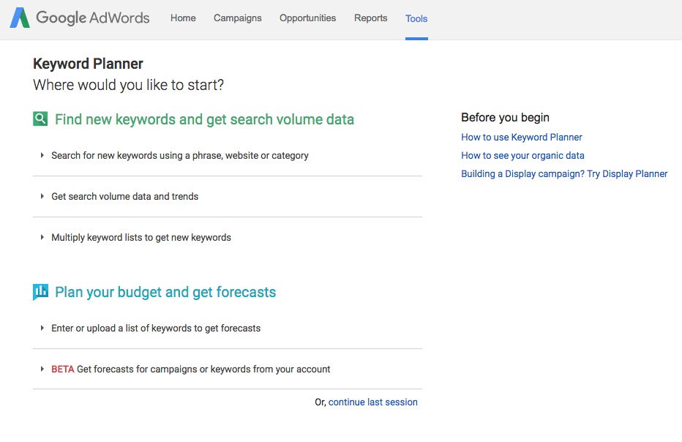

Slide 8
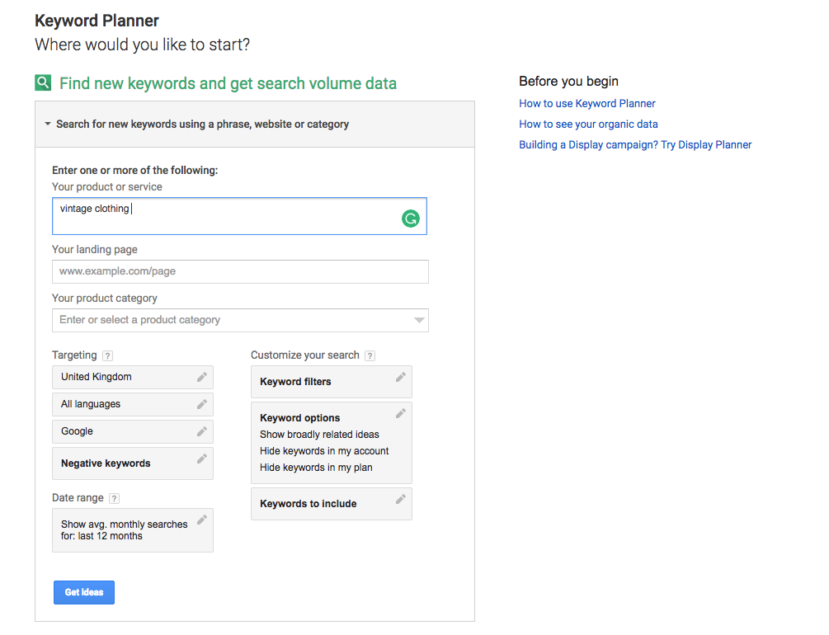

Slide 9
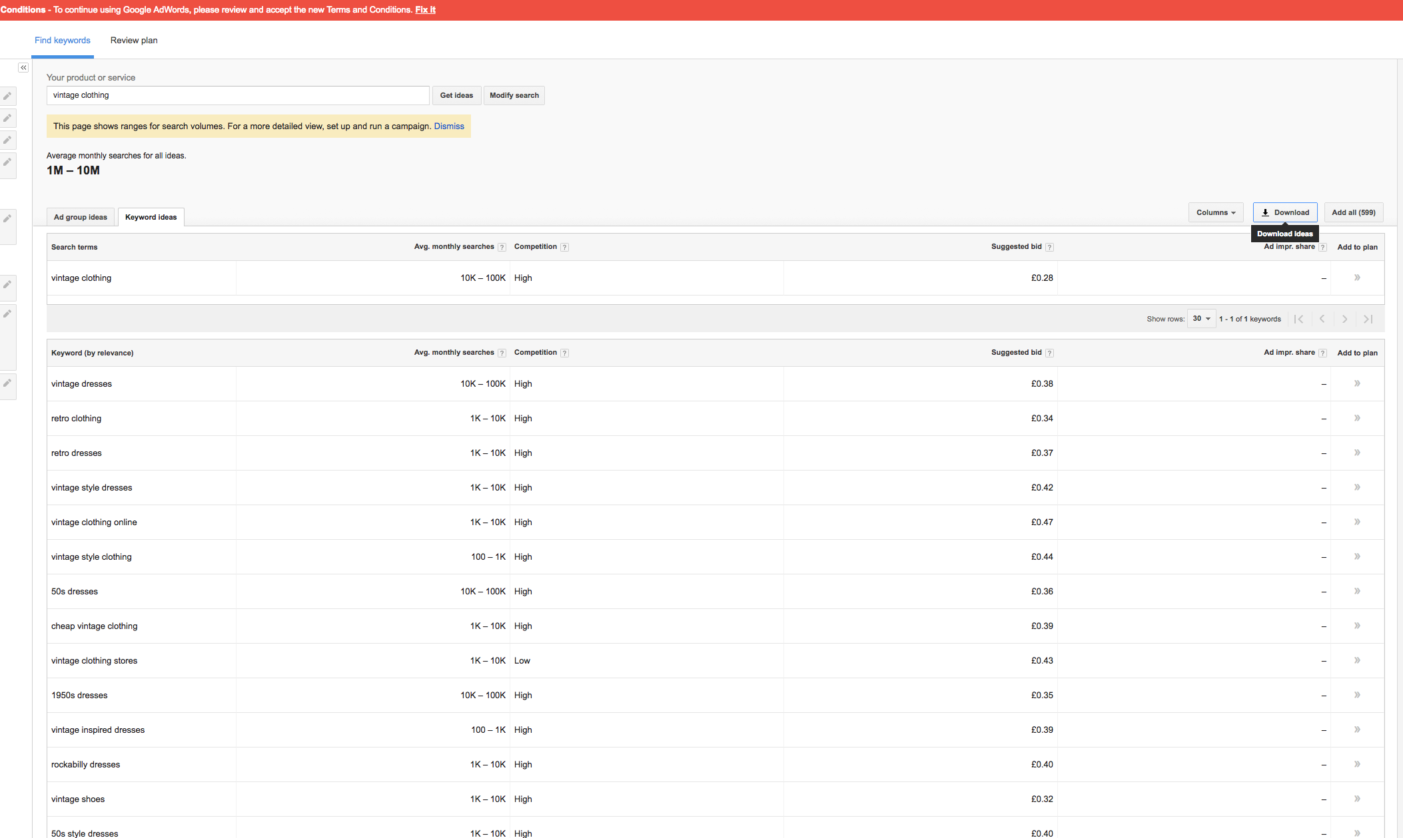

Slide 10
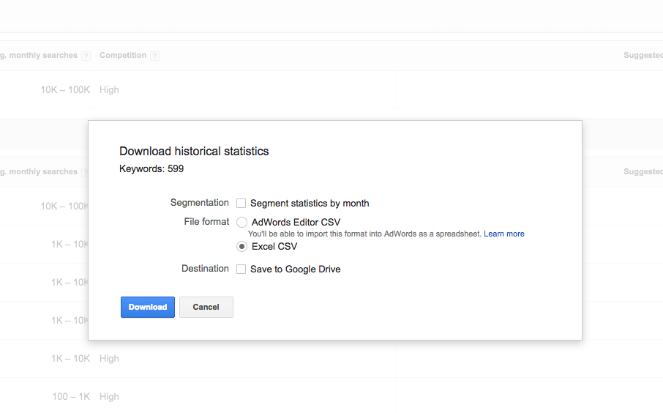

Slide 11
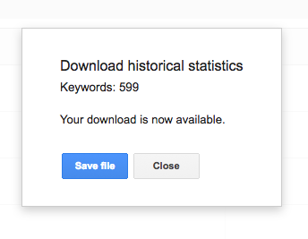

Slide 13
Free
http://www.socialmention.com/

