Slide 1
Get Published on

Slide 2
Introductions

Slide 3
What eBooks sell on Amazon
Formatting for Kindle
Cover Design
The Dashboard
Marketing Books - cost-effectively and through social media, blogs and websites

Slide 4
Kindle Direct Publishing is Amazon.com's e-book publishing unit launched in November 2007, concurrently with the first Amazon Kindle device. Amazon launched Kindle Direct Publishing (KDP), originally called Digital Text Platform, to be used by authors and publishers to independently publish their books directly to Kindle and Kindle Apps worldwide. https://www.statista.com/topics/846/amazon
Authors can upload documents in several formats for delivery via Whispernet and charge between £0.99 and £200.00 for their works.
These documents may be written in 34 languages.
In 2016, Amazon also added a paperback option which uses print-on-demand technology with the goal of offering digital and print to self-publishers.

Slide 5
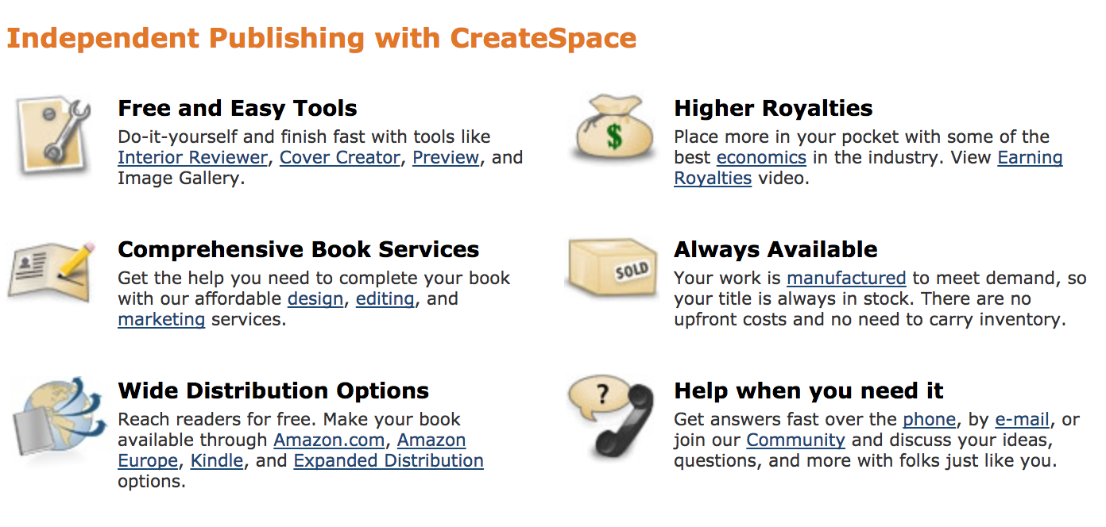
Amazon has been promoting to its authors the capability of publishing both e-books and paperbacks through the same platform. KDP's paperback option is called a "beta feature" on their website. Amazon's has another self-publishing option, CreateSpace, that is still online and running so it is not clear if KDP will phase out CreateSpace; Amazon's website promotes that KDP has the advantage of linking a user's paperback and digital books in one place.
https://www.createspace.com/

Slide 6
Romance, science fiction, and fantasy books are the best-suited for self-publishing. In fact, half of the e-book bestsellers in the romance, science fiction, and fantasy genres on Amazon are self-published!
Remember - Readers of these genres are more likely to share recommendations via blogs and community forums, and their clearly defined interests make it easier for authors in these genres to target their book sales marketing efforts.

Slide 7
Of these three genres, romance books make up a whopping 40% of the market share on Amazon e-book sales. And if you think romance sells so well because it’s erotica—not true. Only 1.2% of Kindle sales are erotica. The romance genre actually covers many other types of romance novels—even Christian romance.

Slide 8
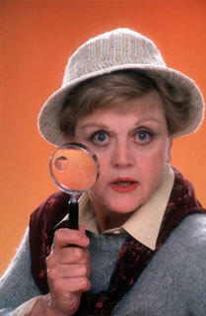
Mystery, Thriller, Crime
Of the Top 100 mystery and thriller Kindle sales, 11% are self-published books. While not as popular as the romance genre, self-published mystery, thriller, and crime books still sell extremely well.

Slide 9
Nonfiction
Nonfiction books are also good choices for self-publishing. They make up a smaller percentage of the market, but readers are often happy to pay more for a nonfiction book. So even if you sell fewer books than fiction writers, you’ll still make a decent profit because you can charge more for each copy.
Self-published literary fiction doesn’t sell as well as genre fiction does: This category makes up only 2% of all Amazon e-book sales.

Slide 10
How to Format Your Book for Kindle Using Microsoft Word
Most eBooks consist of these page-braked sections:
Title page, including author’s name and publishing house (if applicable)
Copyright page
Dedication
Acknowledgements
Table of Contents
Foreword (if applicable)
Introduction
Body/Chapters
Conclusion
About the Author
Appendices including Bibliography, Glossary and Advertisements
Index (only when using a professional eBook programmer

Slide 11
Top Tip!
Use https://app.grammarly.com/ for proofing your work as you go. Starts off with a Free Basic Package

Slide 12
Which fonts – from the writers forum
Times New Roman – was actually designed for the narrow columns of newspaper publishing, so it is not the best for Kindle
Bookman Old Style with Verdana for Chapters and TOC
Sans-serif family
Courier

Slide 13
Top Tip!
Download free fonts by clicking here…
http://www.1001fonts.com/

Slide 14
Think about your cover…
Using Cover Creator
If you don't have a cover for your book, you can use KDP's Cover Creator to make one based on an image you provide or a selection from our gallery of stock images.
Customize your cover with a variety of layouts and font options.
https://kdp.amazon.com/en_US/help/topic/G201113520

Slide 15
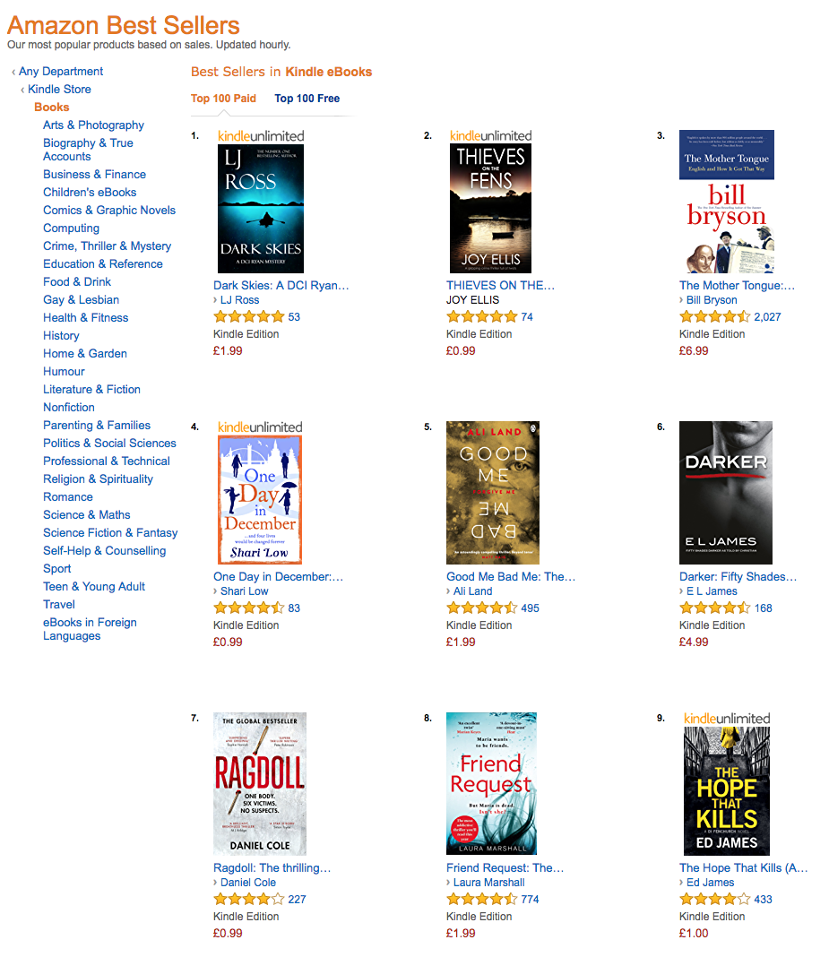
https://www.amazon.co.uk/Kindle-eBooks-books/b/ref=sv_kinc_1?ie=UTF8&node=341689031

Slide 16
Worth a look…
https://www.bookstr.com/15-of-the-funniest-romance-novel-covers

Slide 17
Images
Image resolution measures the quality and clarity of an image. For eBooks, image resolution is measured by pixels per inch (PPI). Images with high PPI (300 or higher) will be clearer than those with low PPI (less than 300).
There is a direct relationship between image PPI and image size. For example, an image that is 300 PPI at 1" x 1" (2.5 x 2.5 cm) is high-resolution. However, if you increase that image to 2" x 2" (5 x 5 cm), the resolution decreases by half to 150 PPI.

Slide 18
Be Careful…
You must own all images within the eBook
Have permission to use all images (credit to be given if necessary)
Have the correct licensing agreement from iStock, Getty, etc
Top Tip! FREE image site - https://pixabay.com
Do not use images from search engines – like Google or social media

Slide 19
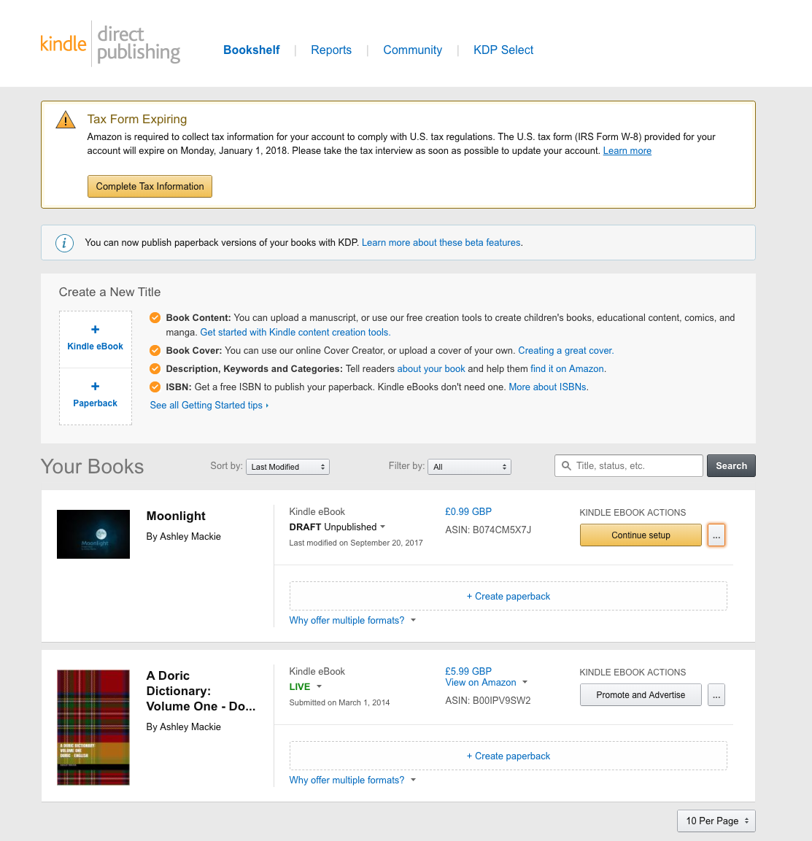
The Dashboard

Slide 20
Advertising for KDP eBooks
Advertise your KDP eBooks on Amazon.com through Amazon Marketing Services (AMS). You set the budget you want to spend and the maximum amount you're willing to pay when a customer clicks on your ad. Depending on the ad type, customers who click on your ad will go to your book's detail page or to a landing page with a summary of your eBook. Charges accrue only when your ad is clicked
https://kdp.amazon.com/en_US/help/topic/G201499010

Slide 21
Royalties
If you select the 35% royalty option, your royalty will be 35% of your list price without VAT for each unit sold.
If you select the 70% royalty option, your royalty will be 70% of your list price without VAT, less delivery costs (average delivery costs are $0.06 per unit sold, and vary by file size), for each eligible book sold to customers in the 70% territories listed below, and 35% of the list price for each unit sold to customers residing outside the 70% territories.
If we sell your digital book at a price below your list price without VAT in order to match price with a third party selling any digital or physical edition of the book, or to match Amazon’s price for a physical edition of the book, you will receive 70% of our sale price for each eligible book sold to customers in the 70% territories, less delivery costs, and less any applicable VAT. For additional details, see the Pricing Page and Terms and Conditions.

Slide 22
The 70% royalty option only applies to books sold to customers in the countries listed below. You do not need to live in one of the 70% territories in order to receive the 70% royalty option.
Andorra
Australia (including territories Christmas Island (CX), Cocos Keeling Islands (CC), Heard & McDonald Islands (HM), and Northfolk Island (NF))
Austria
Belgium
Brazil*
Canada
France
Great Britain
Guernsey
Germany
Gibraltar
India*
Italy
Ireland

Slide 23
Isle of Man
Japan*
Jersey
Lichtenstein
Luxembourg
Monaco
Mexico*
Netherlands
New Zealand (including territories Cook Islands (CK), Niue (NU), and Tokelau)
San Marino
Switzerland
Spain
United Kingdom
United States
Vatican City

Slide 24
https://play.google.com/books/uploads
You need a Gmail account to start with
Price point needs to be the same or cheaper than Amazon
You, as the publisher, will receive 52% of the list price (tax exclusive). If the book is sold in a country outside of your home currency then it will be 52% of that country's currency which will then be converted to your home currency using the foreign exchange rate in effect at the time of the sale.

Slide 25
Remember!
You can edit the price point at any point (24 hours)
You can edit the content at any point
Remove the book
View sales at anytime
X-Ray
General reference information is preloaded into a small file on the Kindle device or app, so that when the feature is used, there is no need to access the Internet (which can disturb a user's experience) to access such content as dictionary, encyclopedic, or metadata entries, or information about actors featured in a film.

Slide 26
How to market…
Introduction / Summary
This section is a short summary of more detailed information in your marketing plan. If it makes things easier, write this section last.
Describe your book.
Describe current market conditions.
Briefly summarize your target buyers and readers.
Briefly summarize your goals or objectives.
Summarize your marketing strategy.

Slide 27
How to market…
Your Target Market
This section describes the ideal buyers of your book. Everything else will be tailored to them.
What are the demographics of your ideal readers? (age, gender, education, location, etc.)
Are there other groups of potential buyers you should target? (such as a children's author targeting teachers and parents rather than just trying to appeal to their target readers)
What are the primary needs of your target market (and how does your book satisfy those needs)
What factors and emotions are likely to influence buying decisions within your target market? You'll want your marketing messages to appeal to those things.
In what ways, places, or media are your target buyers going to be easiest to reach?

Slide 28
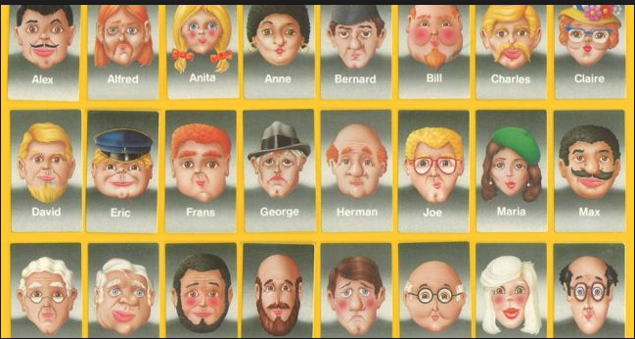

Slide 29
Market Analysis
This section is where you explore larger market trends and issues that could influence your book sales (changes in technology, legislation related to your book's niche, trends in consumer behavior, etc.).
What are the critical issues facing you in reaching readers with your book?
What are your keys to success (where do you have the most opportunity to succeed)?
What distribution channels will you use?
What larger market forces could affect your book sales (genre trends, print book vs e-book buying habits, etc.)?

Slide 30
Competitive Analysis
This section of your book marketing plan is where you evaluate the competition and see how you stack up against them.
Who is your competition?
How are top-selling competitors pricing similar books?
How is the competition promoting and distributing their books?
What are your competitors doing well, or better than you?
Where are your competitors struggling (where can you do better than them)?

Slide 31
Marketing Objectives
This section is where you list your marketing goals or objectives. Use S.M.A.R.T. goals here -- they should be specific, measureable, achievable, realistic, and time-sensitive (meaning they should have deadlines). Below are some examples, but you don't have to use all of them and you don't have to limit yourself to them.
How many books do you want to sell? (Your first month, 3 months, 6 months, a year, etc.)
How much do you have to earn to be profitable (cover your production and marketing expenses and the time invested), and by when do you want to hit that target?
How many reviews do you want, and by when? How many total versus 4-5 stars?

Slide 32
Marketing Strategy
This section explains, in broad terms, how you plan to meet your marketing objectives. Think of your objectives as problems that need to be solved, and think of your marketing strategy as your high-level solution. Leave the specific steps and tools for later.
How will branding play a role in helping you sell books?
How will you position yourself among the competition (selling low-priced books versus premium books for example)? What kind of reputation do you want this book to have, or how do you want it to be seen in relation to other books on the market?

Slide 33
Cover the 4 Ps of Marketing:
Product: Provide a detailed description of your book (synopsis) as well as a physical description (length, cover design plans, dimensions, etc.). Also include the benefits your book offers its target readers in comparison to competing titles.
Price: How will you price your book? Will you offer discounts or sales from time to time? What kind of payment methods can you accept (for direct sales)?
Promotion: Summarize your key marketing tactics and tools (will you focus mostly on public speaking, social media marketing, etc.)? You'll cover these in more detail in the next section.
Placement: What specific marketplaces will carry your book? Will you sell directly in-person? Where? Will you sell through your own website? On what page, and through what distribution services, if any? In other words, how and where will your book be accessible to readers?

Slide 34
What print tactics will you use (bookmarks, mailers, posters, etc.)?
How will you use your website or blog to promote your book and build relationships with readers?
Will you use speaking engagements to promote your books?
What about webinars or online courses?
What social networks will you use, and what will you do to promote your books on each of them?
What other online marketing tactics can you use?
What other offline marketing tactics can you use?
Create a marketing calendar (Gantt charts are a good option) so you know when each action or tactic will be scheduled. Some will be ongoing. Others will have deadlines. The idea is to make sure your tactics complement each other at any given time so you don't spread yourself too thin. Setting a marketing schedule up front also ensures that you won't wait until the last minute -- like launch day -- to start building visibility for your book.

Slide 35
What I realistically suggest…
Set up a website – preferably either your name; the name of the book; or something closely related
I would recommend using Weebly (£20) per year including domain
https://www.weebly.com/login
Or
Wordpress roughly £100 per year including domain
https://wordpress.com/

Slide 36
Apply to register a trade mark?
https://www.gov.uk/how-to-register-a-trade-mark/apply

Slide 37
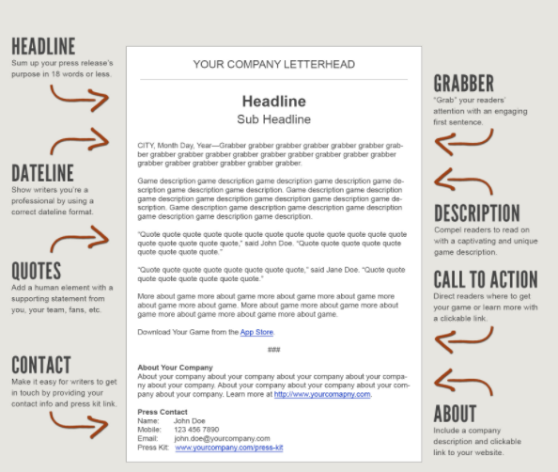
Send a press release to local media and sector publications

Slide 38
Send a press release to local media and sector publications
PR list of Henley and surrounds media contacts –
email ashley@ashleymackie.com if you need further contacts!

Slide 39
Author Central
https://authorcentral.amazon.co.uk

Slide 40
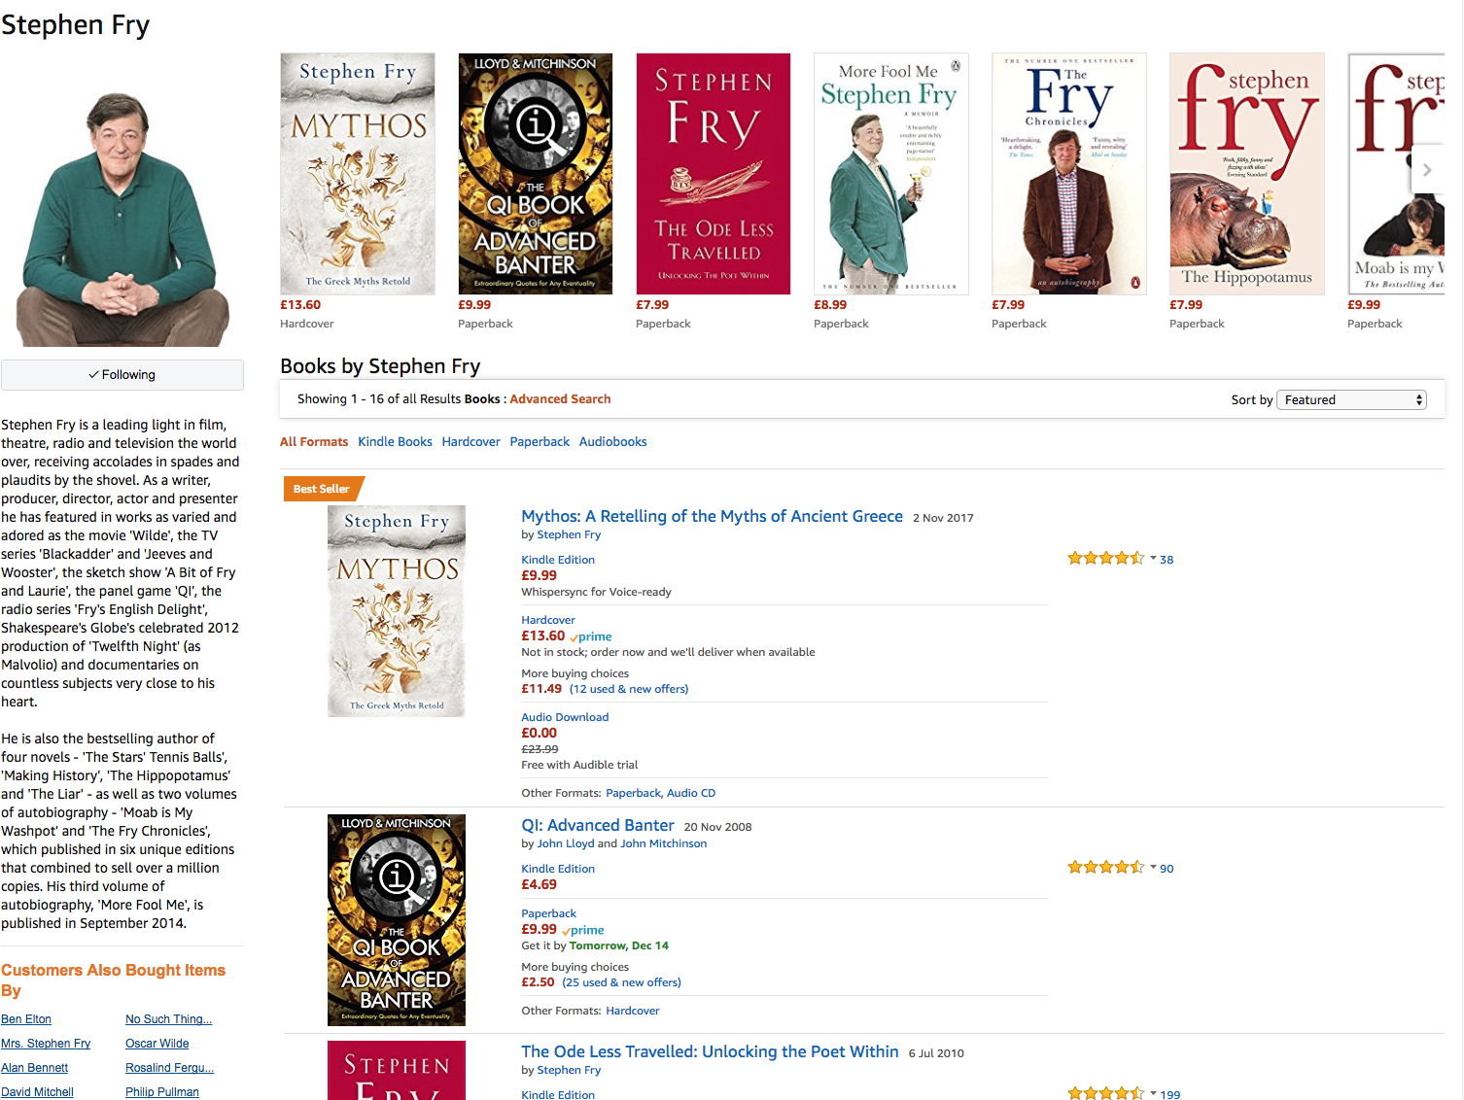
Author Central
https://authorcentral.amazon.co.uk

Slide 41
Social Media

Slide 42
Social Media
Be consistent!
#eBook #Amazon #KDP #Kindle #Crime #Cookery #TheNameOfYourBook

Slide 43
Get out and about
http://www.literaryfestivals.co.uk/
Book clubs – ask them to review your book
Do a reading at a 60+ club, hospital, school – captive audience

Slide 44
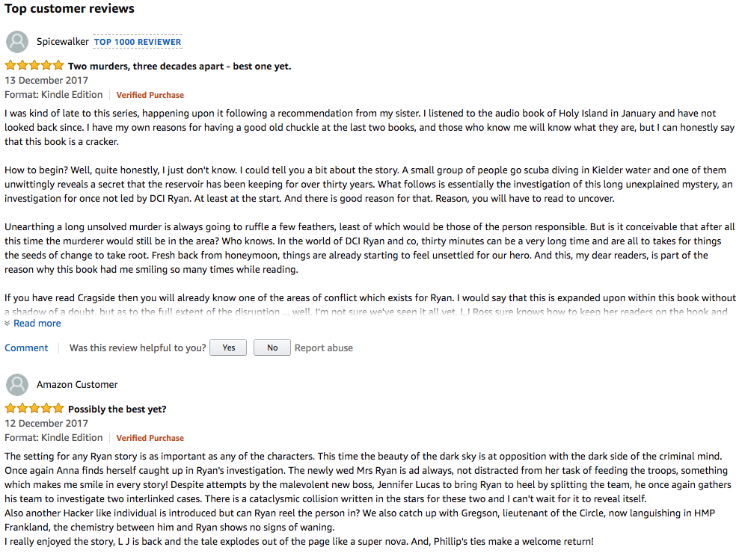
Reviews

Slide 45
Manuscript Proof-Reading - following the course and I can read your manuscripts and help with typos, etc and give some feedback on what can be improved before you publish on ADP.

Slide 46
I can also offer assistance on uploading and how to market the book – if needed.

Slide 47
Questions?

Slide 48
ashley@ashleymackie.com
Downloads available on
www.Talentedmarketing.com

