Slide 1
Facebook

Slide 2
When Facebook started in 2004, it was a bare-bones social network focused on connecting college students ‘The Face Book’
13 years and more than 1 billion active users later, Facebook has become the most widely-used social network to date and has shaped online interaction as we know it. From connecting distant friends and family members, to bridging the gap between brands and their communities, Facebook has taken the way we interact online to a whole new level.

Slide 4
Groups
Groups are user-created and have varying levels of
privacy and security, much like individual profiles. Users can organize groups around any topic or event they like.
From professionally relevant groups to those organized around special interests, such as nutrition, the variety is limited only by interest of the users. These groups have undoubtedly been a welcome and sticky addition to the platform over time.

Slide 5
Events
Events allow users to organize around a point in time.
Security here is fairly customizable, allowing for public, private, and somewhere-in-between events.
A key feature here is the baked-in ability to export your Facebook events to other calendars, no doubt increasing usage and reliance on this feature that blends users' personal and professional lives.

Slide 6
Business Pages
Business pages have been an evolutionary
product for Facebook. Over the years, they have taken
several different shapes, though they are fairly stable today.
Like other types of pages, the feature set is ever-evolving as
they add more to meet the needs of the marketers behind
the brand's efforts. Facebook has recently added more
features in terms of analytics, reporting, security, and
access, as well as increased the richness available to those
wishing to dive into Facebook advertising.

Slide 7
Facebook Messenger
Facebook Messenger is a new way to
combine email, instant messenger, and Facebook
messages.
As new stand-alone group message services
popped up throughout 2010 and 2011, Facebook clearly
saw an opportunity and acquired one of the more popular
group-messaging apps known as Beluga. They have since
re-branded this app as Facebook Messenger.
On iOS, Blackberry, and Android devices, this is a stand-alone app, but it also integrates across the Facebook app and web
experiences.

Slide 9
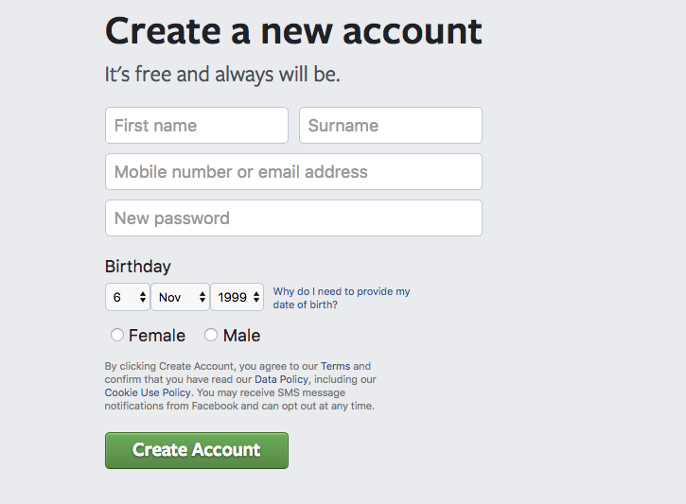
Setting up a new personal account
Go to https://www.facebook.com/r.php

Slide 12
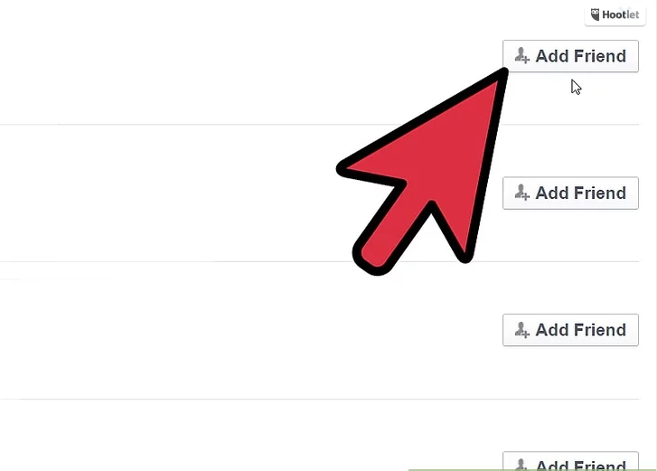

Slide 15
Posting

Slide 16
Best time of day to post on Facebook?

Slide 17
Hashtags
Hashtags turn topics and phrases into clickable links in your posts on your personal timeline or Page. This helps people find posts about topics they’re interested in. To make a hashtag, write #(the number sign) along with a topic or phrase and add it to your post. For example:
I just saw the cutest puppy! #dogs
When you click a hashtag, you’ll see a feed of posts that include that hashtag. You may also see some related hashtags at the top of the page.
Please keep in mind:
A hashtag must be written as a single word, without any spaces
You can include numbers in a hashtag, but punctuation and special characters (like $ and %) won't work
You can search for a hashtag using the search bar at the top of any page
You'll only see posts that were shared with you

Slide 18
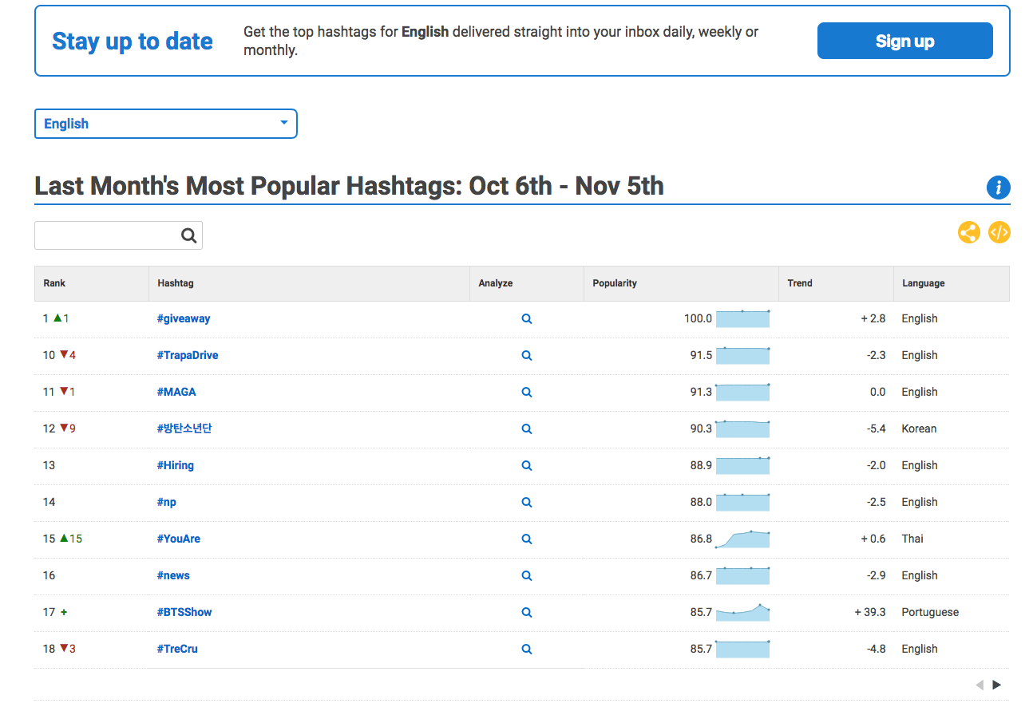
Helpful resource
www.hashtagify.me/

Slide 19
Setting up a group page
You must have a personal profile

Slide 22
Facebook for Business
A helpful portal for business page owners offering support for page creation, ad campaign management, and other platform resources.
You must sign –up separately for FfB, however, you will be able to link page roles once you have set-up
Analytics and insights

Slide 23
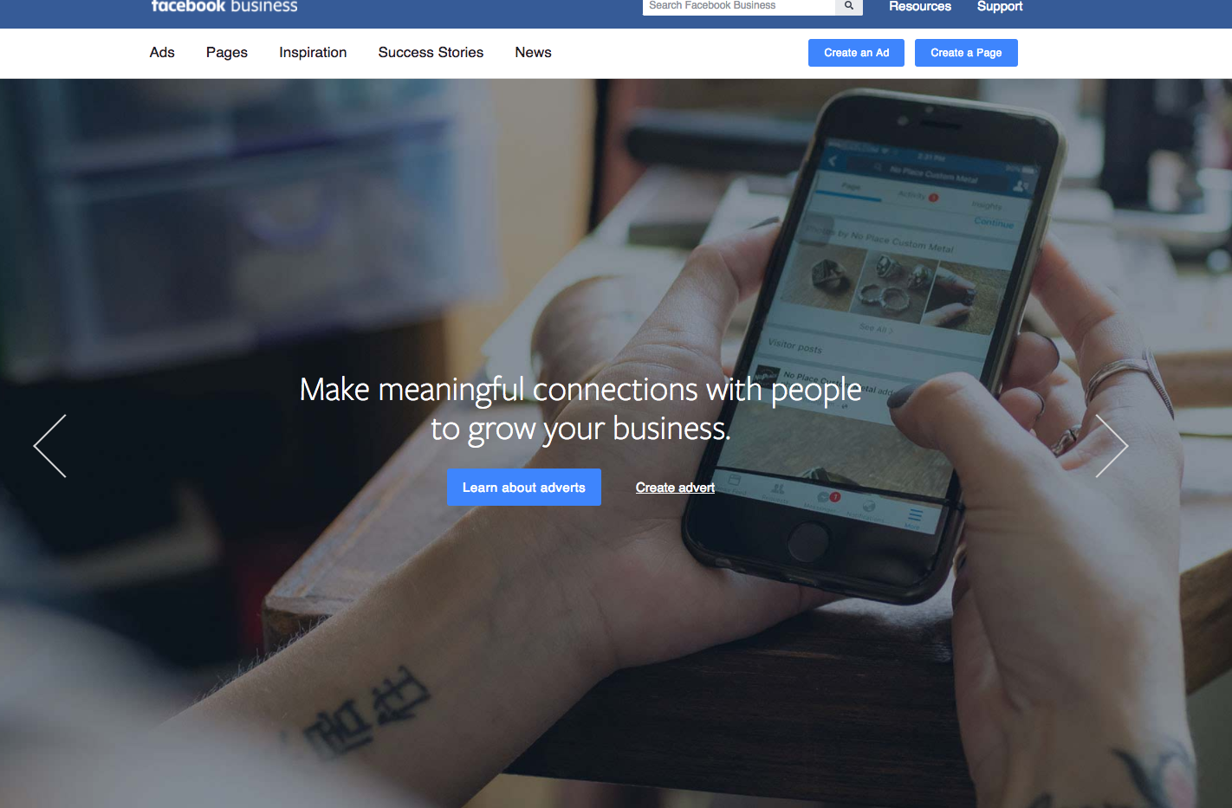

Slide 24
Questions?

